Slide 1
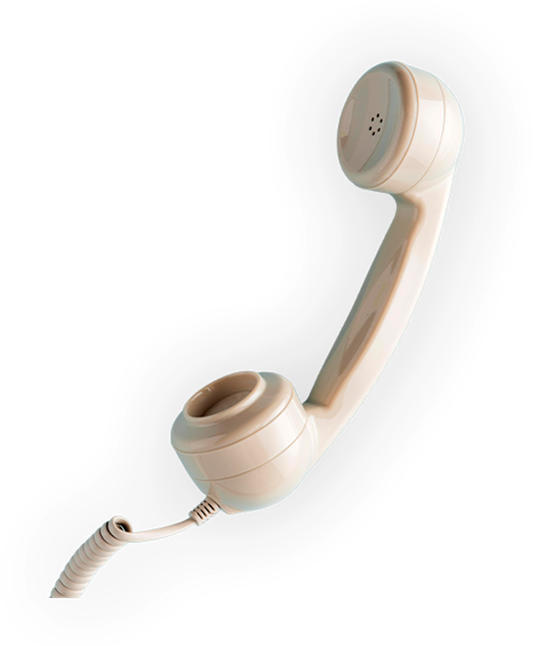
G02-L-Static-009
Topic 1 | Page 1
Language tips: getting the words right
<write voice over text here>
Please
Let me help you
Thank you
Got you
I’ll take care of it
Happily
I recommend
Exactly, you’re right
<include graphic notes here>
I understand

