Slide 1
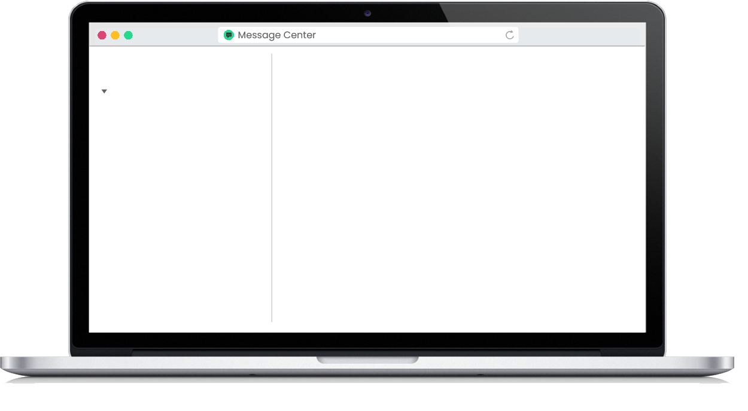
G04-H-Scenario-With-Activity-005-SL
Topic 1 | Page 1
<write voice over text here>
Messages (3)
Starred
Laura
+1
You have 3 unread messages. Select a team member to view the chat and respond.
Carlos
+1
Emily
+1
Background image ID <>

Slide 2
<write voice over text here>
Laura
Text about a real-life problem or concern that requires a response.
Manager
Select/drag the correct response.
This is the correct response.
Background image ID <>
This is an incorrect response.

Slide 3
<write voice over text here>
Laura
Text about a real-life problem or concern that requires a response.
Manager
This is the correct response.
That’s right!
Background image ID <>
Message

Slide 4
<write voice over text here>
Messages (2)
Starred
Laura
You have 2 unread messages. Select a team member to view the chat and respond.
Carlos
+1
Emily
+1
Background image ID <>

Slide 5
<write voice over text here>
Carlos
Text about a real-life problem or concern that requires a response.
Manager
Select/drag the correct response.
Background image ID <>
This is the correct response.
This is an incorrect response.

Slide 6
<write voice over text here>
Carlos
Text about a real-life problem or concern that requires a response.
Manager
This is the correct response.
That’s right!
Background image ID <>
Message

Slide 7
<write voice over text here>
Messages (1)
Starred
Laura
You have 1 unread messages. Select a team member to view the chat and respond.
Carlos
Emily
+1
Background image ID <>

Slide 8
<write voice over text here>
Emily
Text about a real-life problem or concern that requires a response.
Manager
Select/drag the correct response.
Background image ID <>
This is the correct response.
This is an incorrect response.

Slide 9
<write voice over text here>
Emily
Text about a real-life problem or concern that requires a response.
Manager
This is the correct response.
That’s right!
Background image ID <>
Message

Slide 10
<write voice over text here>
Messages (0)
Starred
Laura
You’re all caught up! Nice work! You can exit this course.
Carlos
Emily
Background image ID <>

