Slide 1
G04-H-Scenario-With-Activity-008
Topic 1 | Page 1
Practice
The way you open a customer meeting is critical in setting the tone for your interaction.
Whether it is your first meeting or your tenth, the impression that you make with the customer in your opening will ensure your customer is comfortable, engaged, and ready for the next step.
For an effective opening, if you would like to review the process before you begin, select the Process button. It will also be available to you throughout the exercise.
<write voice over text here>
Name 1
Name 2
Name 3
Scenario 1
Scenario 2
Scenario 3
Process
<include graphic notes here>
Start by selecting a scenario.

Slide 2
Process
Before you begin, quickly refresh your memory. This summary is available to you during the activity.
Open the Call:
Greet Warmly
Be confident while introducing yourself and your company. Show genuine enthusiasm and warmth.
Create Connections
Build rapport in a professional and personable way. Assess your customer’s preferred communication style and quickly adapt to it during your interaction.

Slide 3
Practice
The way you open a customer meeting is critical in setting the tone for your interaction.
Whether it is your first meeting or your tenth, the impression that you make with the customer in your opening will ensure your customer is comfortable, engaged, and ready for the next step.
For an effective opening, if you would like to review the process before you begin, select the Process button. It will also be available to you throughout the exercise.
<write voice over text here>
Name 1
Name 2
Name 3
Scenario 1
Scenario 2
Scenario 3
Process
<include graphic notes here>
Start by selecting a scenario.

Slide 4
Scenario 1: Your Role
You are a sales representative for Total Outdoor Living.
Your company sells outdoor furniture ranging from mid-to-high-end quality and pricing.
Your brands are nationally recognized.
The Requirement:
Julia Jaspers, the Buyer from Sunshine Pool and Patio, has sent you an inquiry about the range of outdoor furniture offered by your organization, Total Outdoor Living.
You need to schedule a sales appointment with Julia at the end of this activity.
Start

Slide 5
Question 1
Poor
Good
Conversation Flow
Interest Meter:
<write voice over text here>
Fair
Excellent
Hello, this is Julia Jaspers.
Process
Choose your response.
My Role
Hello Julia, I’m calling from Total Outdoor Living. I received your recent inquiry, and I’m following up on it.
Hello Julia, I’m calling from Total Outdoor Living. I want to set up an appointment with you.
After feedback
Option 1: Navigate to Question 2
Option 2 & 3: Navigate to Question 3
Hello Julia, I’m calling from Total Outdoor Living. We received your inquiry. I have sent you our product brochure through email. Could you confirm you received it?

Slide 6
Question 1 Feedback
Poor
Good
Conversation Flow
Interest Meter:
<write voice over text here>
Fair
Excellent
Hello, this is Julia Jaspers.
Process
My Role
Hello Julia, I’m calling from Total Outdoor Living. I received your recent inquiry, and I’m following up on it.
Best response! This response shows warmth and gives the reason for calling the customer.
After feedback
Option 1: Navigate to Question 2
Option 2 & 3: Navigate to Question 3
Next

Slide 7
Question 1 Feedback
Poor
Good
Conversation Flow
Interest Meter:
<write voice over text here>
Fair
Excellent
Hello, this is Julia Jaspers.
Process
My Role
Hello Julia, I’m calling from Total Outdoor Living. We received your inquiry. I have sent you our product brochure through email. Could you confirm you received it?
Damaging response. This response shows that you are only focused on making the sales and do not care about the customer or her needs.
After feedback
Option 1: Navigate to Question 2
Option 2 & 3: Navigate to Question 3
Next

Slide 8
Question 2
Poor
Good
Conversation Flow
Interest Meter:
<write voice over text here>
Fair
Excellent
Oh yes. I forgot I had sent it – what with all the rush with the new stores and inventory selection for the stores’ upcoming Spring Event.
Process
Choose your response.
My Role
Two stores, that’s great. We would love to be a part of those stores. What can I send you to get that started?
Yes, I found out about them. What type of furniture are you displaying there?
After feedback
Option 1: Navigate to Question 4
Option 2 & 3: Navigate to Question 5
Yes, I did a little research and saw the new stores online. They both have great curb appeal, congratulations on the new stores and Sunshine Pool and Patio’s growth! Is that what triggered your inquiry with us?

Slide 9
Question 3
Poor
Good
Conversation Flow
Interest Meter:
<write voice over text here>
Fair
Excellent
Sorry, I’m really very busy with our two new stores this morning, haven’t even checked my messages. Can you please share the purpose of your call?
Process
Choose your response.
My Role
Two stores, that’s great. We would love to be a part of those stores. What can I send you to get that started?
Yes, I found out about them. What type of furniture are you displaying there?
After feedback
Option 1: Navigate to Question 4
Option 2 & 3: Navigate to Question 5
Yes, I did a little research and saw the new stores online. They both have great curb appeal, congratulations on the new stores and Sunshine Pool and Patio’s growth! Is that what triggered your inquiry with us?

Slide 10
Final Feedback
Poor
Good
Conversation Flow
Interest Meter:
<write voice over text here>
Fair
Excellent
Process
Sounds good. Thanks for calling.
My Role
Great job! You were successful in scheduling a meeting with Julia.
You did a great job. You can now move on to the next activity scenario.
How Did You Do?

Slide 11
Conversation Flow
Close
Performance Indicator
Conversation Quality
<write voice over text here>
Reaction Meter
Key Performance Indicators
Poor
Good
Greet Warmly
Create Connections
Communication style Business oriented
Deliver LPS and Confirm
Fair
Excellent
<include graphic notes here>

Slide 12
Conversation Flow
Close
Performance Indicator
Conversation Quality
<write voice over text here>
Conversation Quality Meter
Individual Conversation Feedback
Question 1
Question 2
Question 4
Question 7
Hello, this is Julia Jaspers.
Hello Julia, I’m calling from Total Outdoor Living. I received your recent inquiry, and I’m following up on it.
Best response! This response shows warmth and gives the reason for calling the customer.
Retake Conversation
Next Story
<include graphic notes here>

Slide 13
Practice
The way you open a customer meeting is critical in setting the tone for your interaction.
Whether it is your first meeting or your tenth, the impression that you make with the customer in your opening will ensure your customer is comfortable, engaged, and ready for the next step.
For an effective opening, if you would like to review the process before you begin, select the Process button. It will also be available to you throughout the exercise.
<write voice over text here>
Name 1
Name 2
Name 3
Scenario 1
Scenario 2
Scenario 3
Process
<include graphic notes here>
Start by selecting a scenario.

Slide 14
Branching Flow
Question 1
Option 1
Option 2
Option 3
<write voice over text here>
Question 2
Question 3
Option 1
Option 2
Option 3
Option 1
Option 2
Option 3
Question 4
Question 5
Option 1
Option 2
Option 3
Option 1
Option 2
Option 3
Question 6
Option 1
Question 7
Option 2
Option 3
Option 1
Option 2
Option 3
<include graphic notes here>
Question 8
Option 1
Final Feedback
Option 2

Slide 15
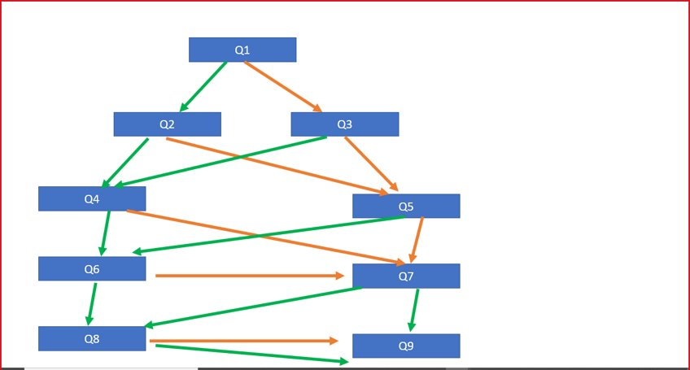
Branching Flow
<write voice over text here>
<include graphic notes here>

