Slide 1
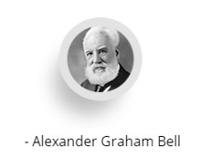
G04-M-Animation-002-SL
Topic 1 | Page 1
<write voice over text here>
“Before anything else, preparation is the key to success.”
Training delivery is an opportunity
<include graphic notes here>

Slide 2
<write voice over text here>
Adults learn best by applying concepts
Learn to maximize engagement
Guide participants
<include graphic notes here>

Slide 3
<write voice over text here>
Prepare to train effectively
<include graphic notes here>

