Slide 1
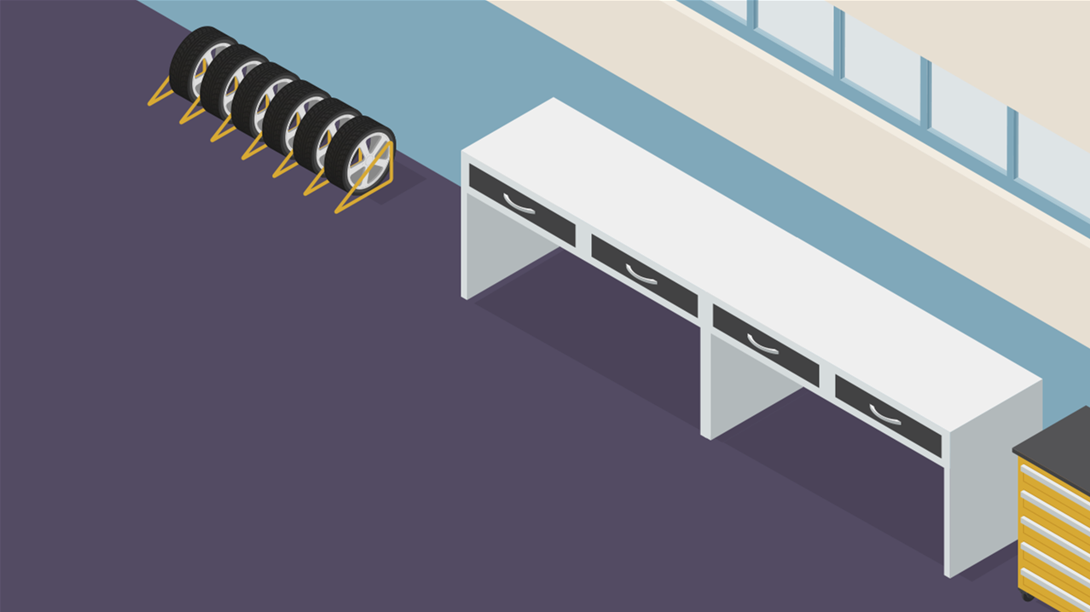

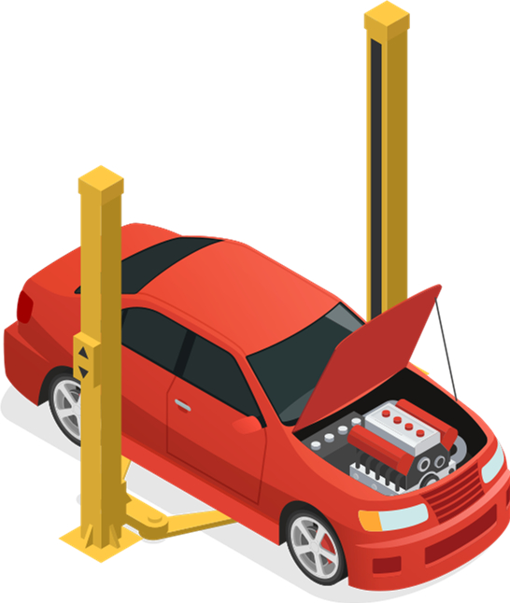




G05-H-DragDrop-Many-to-One-002-SL
Topic 1 | Page 1
<write voice over text here>
<include graphic notes here>
Min: 3 Button | Max: 6 Buttons

Slide 2
Drag an oil bottle to the car to ﬁnd out what it does.
<write voice over text here>
<include graphic notes here>
Min: 3 Button | Max: 6 Buttons

Slide 3
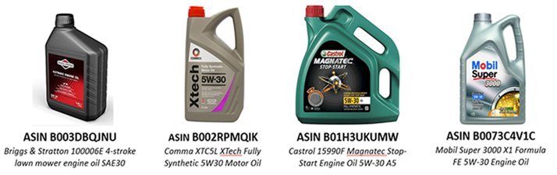
Engine oil
Lubricant
<write voice over text here>
Engine oil
Synthetic motor oil
Start engine oil
Background image ID <>

Slide 4
<write voice over text here>
<include graphic notes here>
Min: 3 Button | Max: 6 Buttons

Slide 5
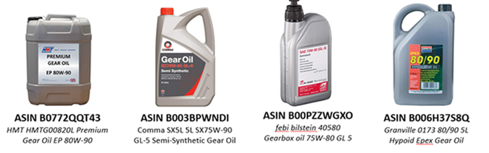
Gear oil
Lubricant
<write voice over text here>
Gear oil
Synthetic gear oil
Gearbox oil
Background image ID <>

Slide 6
<write voice over text here>
<include graphic notes here>
Min: 3 Button | Max: 6 Buttons

