Slide 1
G05-H-Games-001-SL
Topic 1 | Page 1
<write voice over text here>
Would you like to become an
EI Mobile Ambassador?
Go right ahead!
PLAY ALONG
Enable the Attempt the question button once user viewing all clickables.

Slide 2
<write voice over text here>
Before You Begin
Enter your Name
Select your avatar
Learn about the rules and then, get started!
<include graphic notes here>
UNDERSTAND THE GAME
PLAY THE GAME

Slide 3
<write voice over text here>
The EI Mobile
Ambassador award!
Background image ID <>

Slide 4
<write voice over text here>
Be one of
the finalists
Background image ID <>

Slide 5
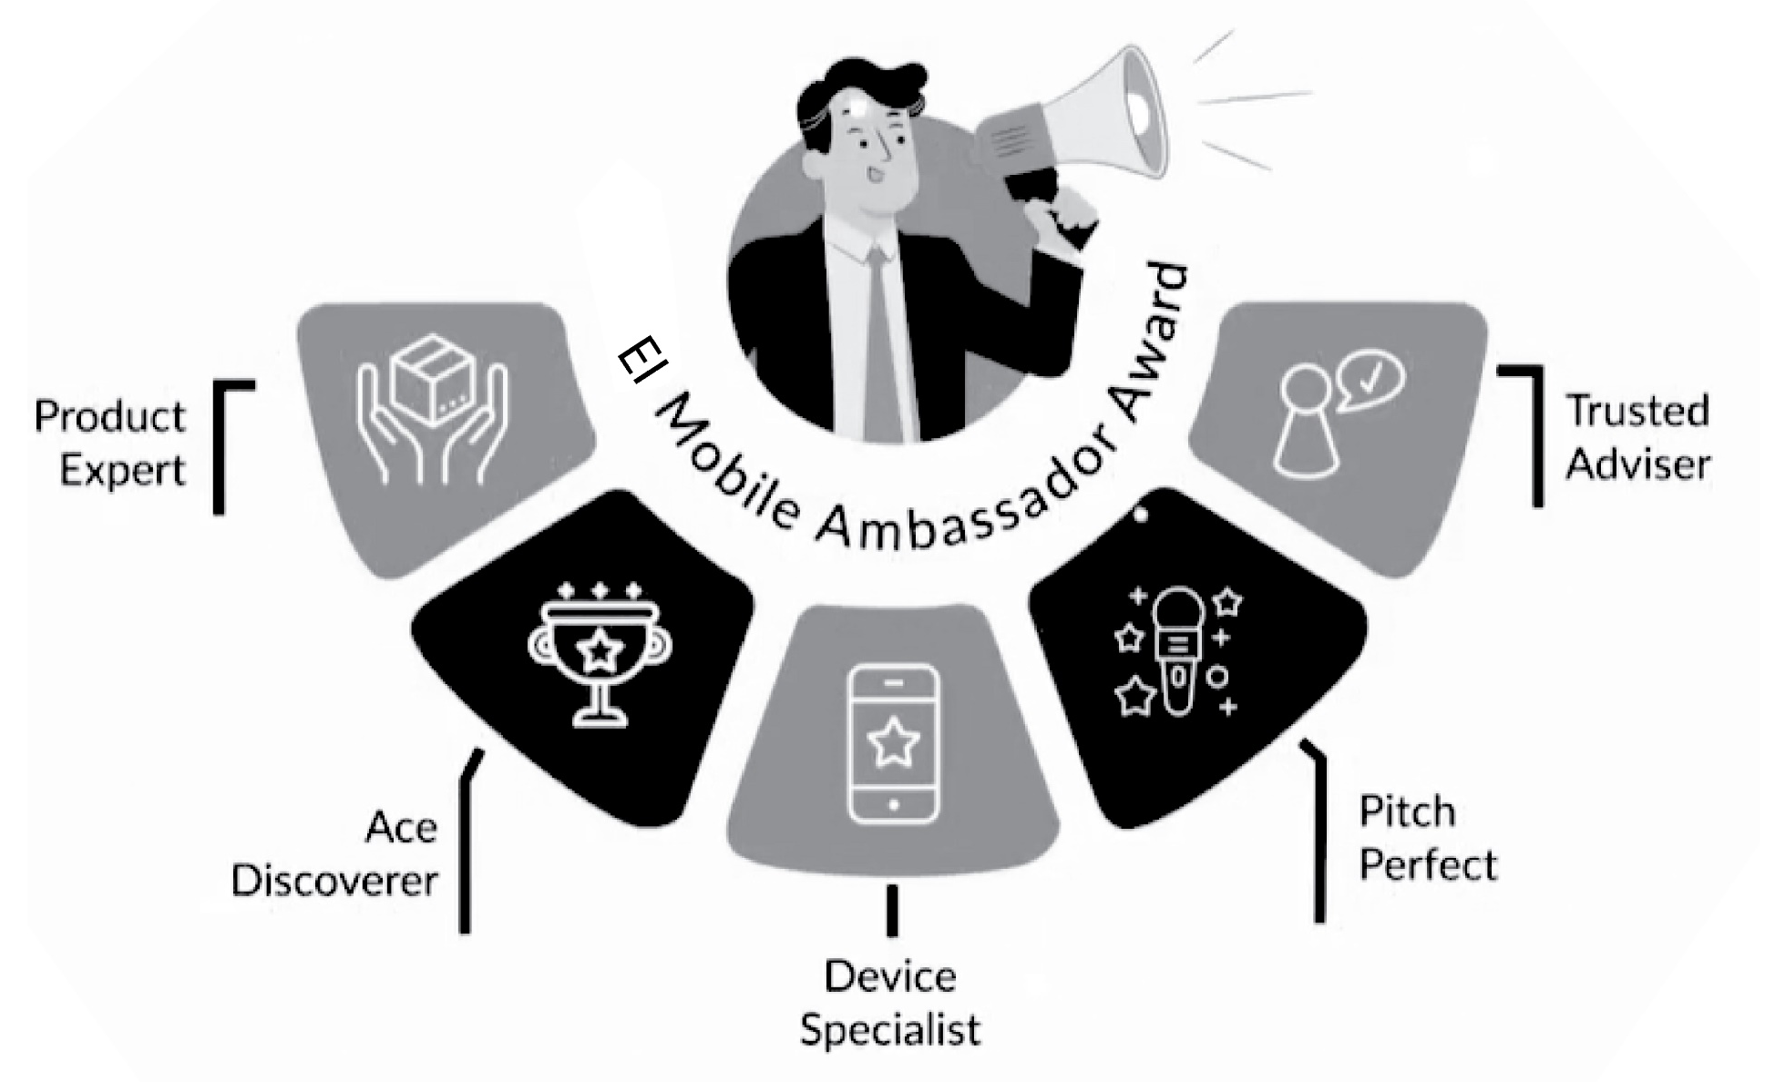
What would you need to do?
<write voice over text here>
Cover 5 stages Complete specific tasks Win badges!
Background image ID <>

Slide 6
The stages check your knowledge about our products.
<write voice over text here>
Background image ID <>

Slide 7
How do you move ahead?
<write voice over text here>
Gain points on
completing each task
Score at least 80% to move from one stage to another
Background image ID <>

Slide 8
<write voice over text here>
Background image ID <>
Collect tips and notes to use during your work

Slide 9
<write voice over text here>
Let’s play!
Background image ID <>

Slide 10
<write voice over text here>
Before You Begin
Enter your Name
Select your avatar
Learn about the rules and then, get started!
<include graphic notes here>
UNDERSTAND THE GAME
PLAY THE GAME

Slide 11
Your Game Board
<write voice over text here>
Play each game Win badges- Get closer to the
EI Mobile Ambassador award!
Select the Game 1 badge to continue
Game 1
Background image ID <>
Game 2
Game 3
Game 4
Game 5

Slide 12
<write voice over text here>
Products and Packaging
Play this game to become a …
Product
Expert
GAME RULES
PROCEED
Background image ID <>

Slide 13
Game Rules
X
<write voice over text here>
Task
Your leadership team wants to gauge your knowledge level of EI Mobile products and packaging. A panel of leaders will ask you a set of questions that you need to answer and score points.
Lifelines
You will get 3 lifelines in this game: 50-50, Hint, and Poll You can use each lifeline only once in the game.
Points Plan
Correct answer: 50 points
Incorrect answer : 0 points
Score required to earn badge : 80%
Lifelines
You will get 3 lifelines in this game: 50-50, Hint, and Poll You can use each lifeline only once in the game.
Background image ID <>

Slide 14
Meet Paul
<write voice over text here>
Proceed to the game and answer the questions from Paul, your leader for this game.
Background image ID <>
START GAME

Slide 15
50-50
Who Wants to Be an EI Mobile Ambassador?
SCORE CARD
Here are your questions. Select each one to mark your answer.
0/400
<write voice over text here>
Poll
Good Luck!
TIMER
Hint
Q1
Q2
Q3
Q4
Q5
Q6
Q7
Q8
Background image ID <>

Slide 16
50-50
Question 1
SCORE CARD
You are troubleshooting with a valued EI Internet customer, and you notice that they qualify for EI Mobile. Their issue is now resolved- Which one of these statements would you choose to show the value of EI Mobile?
0/400
<write voice over text here>
Poll
TIMER
Hint
Select the correct option and Submit
Anyway, we have EI Mobile service, you may want to sign up.
Did you know we offer mobile now and have great offers?
EI Mobile can save you hundreds of dollars on your bill, and you get SG at no additional cost (with a 5G compatible device).
I know you have been with us for about 14-15 years — I can get you a gift by signing up with a free phone.
Background image ID <>
SUBMIT

Slide 17
50-50
Question 1
SCORE CARD
You are troubleshooting with a valued EI Internet customer, and you notice that they qualify for EI Mobile. Their issue is now resolved- Which one of these statements would you choose to show the value of EI Mobile?
0/400
<write voice over text here>
Poll
TIMER
Hint
Select the correct option and Submit
Anyway, we have EI Mobile service, you may want to sign up.
Did you know we offer mobile now and have great offers?
EI Mobile can save you hundreds of dollars on your bill, and you get SG at no additional cost (with a 5G compatible device).
I know you have been with us for about 14-15 years — I can get you a gift by signing up with a free phone.
Background image ID <>
SUBMIT

Slide 18
<write voice over text here>
X
EI Mobile's 5G network provides faster speed and more reliable service.
10%
EI Mobile gives access to millions of WiFi hotspots and a powerful nationwide 5G network at no additional cost.
15%
EI Mobile's 5G network and millions of WiFi hotspots provides faster speeds that makes streaming and gaming easier than ever, with no lag or latency. Auto-connecting to WiFi ensures reliability and saves data usage while securely streaming or browsing.
59%
Are you having issues with streaming and latency on your current mobile device? With EI Mobile's 56 network, you will have faster speeds and more reliable service.
Background image ID <>
20%

Slide 19
<write voice over text here>
X
One of the best benefits is your ability to access millions of WiFi hotspots. Lead with that.
Background image ID <>

Slide 20
<write voice over text here>
Well done!
X
Incorrect!
Superb! You just nailed it Highlighting that this service saves hundreds of dollars on the bill and provides 56 at no extra cost would really help make a sale.
Good try but that's not the best way to present the product. Be sure to explain how El Mobile's 5G network and WiFi hotspots provide faster speed and save data to help Yohan with his streaming and gaming requirements.
UNLOCK TIP
Background image ID <>

Slide 21
<write voice over text here>
How Did you Fare?
Congratulations!
Hey Paul,
You have won the badge.
You need to reattempt the game to score at least 80%.
Background image ID <>
REATTEMPT GAME
PLAY GAME 2

