Slide 1
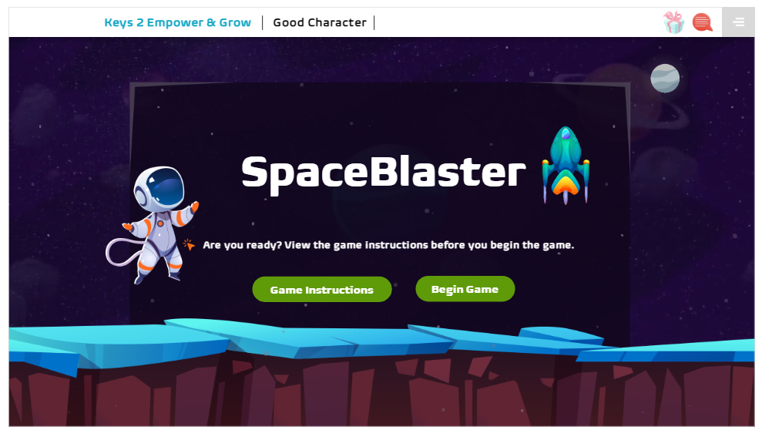
G05-H-Games-009-SL
Topic 1 | Page 1
Game: Laser down the invader spaceships.
Functionality: User should be able to shoot the answers with wrong options. while the options are moving on the screen fast.
(Give sound/audio as in video games when the user attempts to catch the option.)
Also show some dummy missiles falling as distracters and increase level of difficulty.
Options move top to down and left to right. (Give sound/audio as in video games for moment)
Add timer to the game.
Shoot down all Incorrect options – Give 20 points (Show performance indicator green when all incorrect answers are shot)
If user shoots on correct option - 0 points (Show performance indicator red and a try again option)
100 points total for 5 questions. 80% passing criteria.
Give a golden key when all 5 questions are correct.
<write voice over text here>

Slide 2
G05-H-Games-010-SL
Topic 1 | Page 1
Space BIaster
<write voice over text here>
Are you ready?
View the game instructions before you begin the game.
Game Instructions
Begin Game

Slide 3
<write voice over text here>
Game Instructions
See UFOs with correct and incorrect answers.
Shoot the wrong invader UFOs move left/right and release.
Earn 60 points to get a Golden Key.
<include graphic notes here>

Slide 4
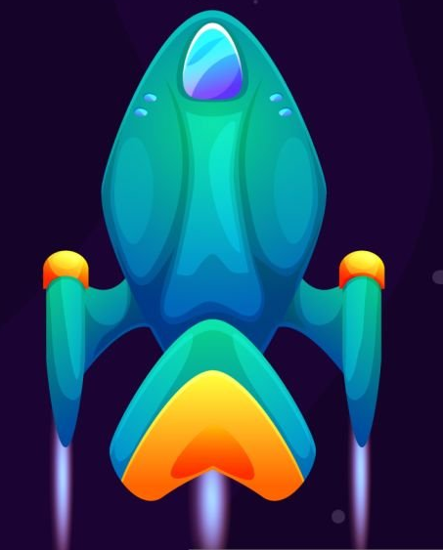
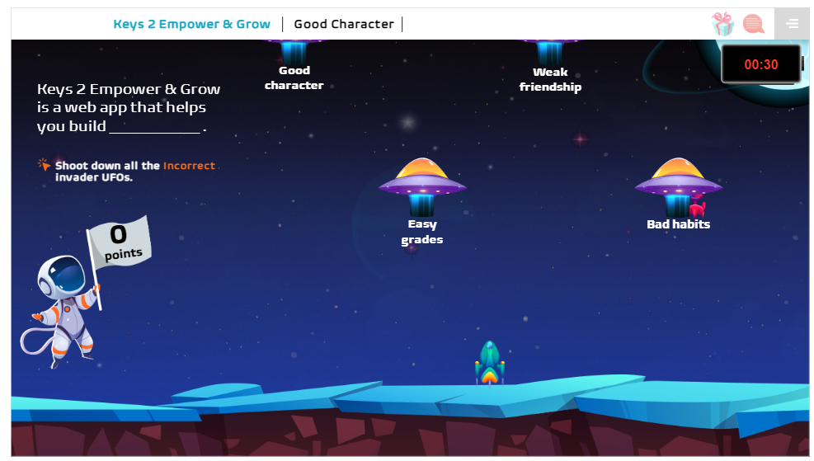
Keys 2 Empower & Grow is a web app that helps you build_____________
Shoot down all the Incorrect invader UFOs.
30 Seconds
Out of Time!
Continue
Weak friendship
Good Character
Bad habits
Easy grades
Background image ID <>
Good Job! Continue
Oops! You Shot down the friendly spaceship. Please Try Again

Slide 5
When you speak to someone, always have good ________ movement.
Shoot down all the Incorrect invader UFOs.
30 Seconds
Out of Time!
Continue
eyes and hands
eye and head
body and toes
Background image ID <>
Good Job! Continue
Oops! You Shot down the friendly spaceship. Please Try Again

Slide 6
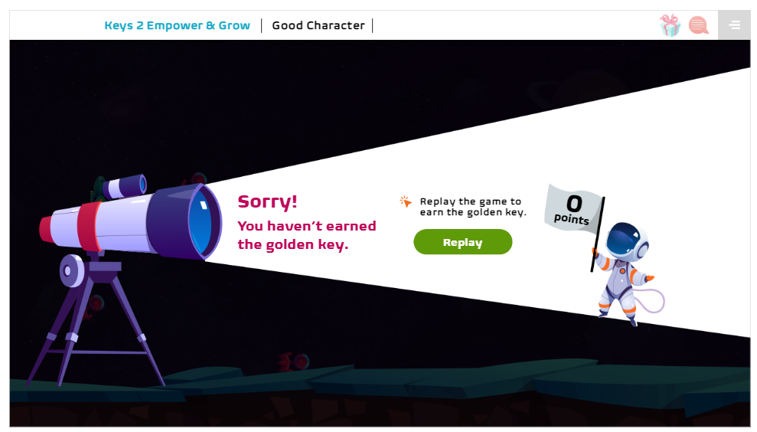
Your Results
Sorry!
you haven’t earned the golden key.
Replay the game to earn the golden key.
Replay
<include graphic notes here>

Slide 7
Your Results
Awesome!
You have successfully given the supplies to the scientists on Mineral Island and earned a Golden Key.
Replay the game if you wish .
Select "Continue" to return to Adventure City.
Continue
<include graphic notes here>

