Slide 1
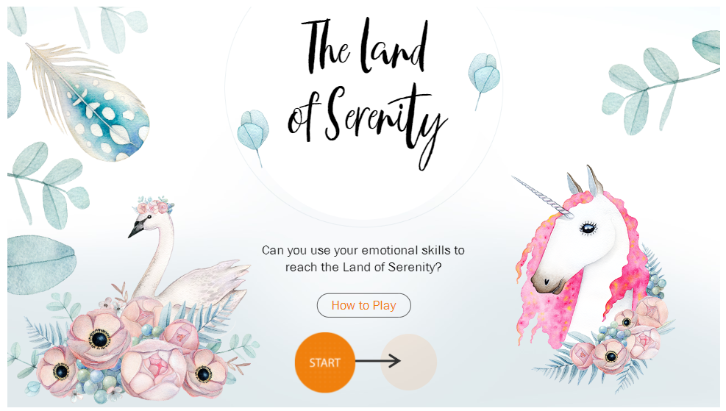
G05-H-Games-011-SL
Topic 1 | Page 1
The Land of Serenity
<write voice over text here>
Can you use your emotional skills to reach the Land of Serenity?
How to Play
START

Slide 2
<write voice over text here>
The game is simple.
Just read the scenarios given to you, and choose the best response in each of them to travel towards the Land of Serenity.
For the most appropriate response, you will travel 30 miles; for a response that could work but isn’t the most appropriate, you will travel 10 miles.
* For incorrect responses, you will stay where you are.
<include graphic notes here>

Slide 3


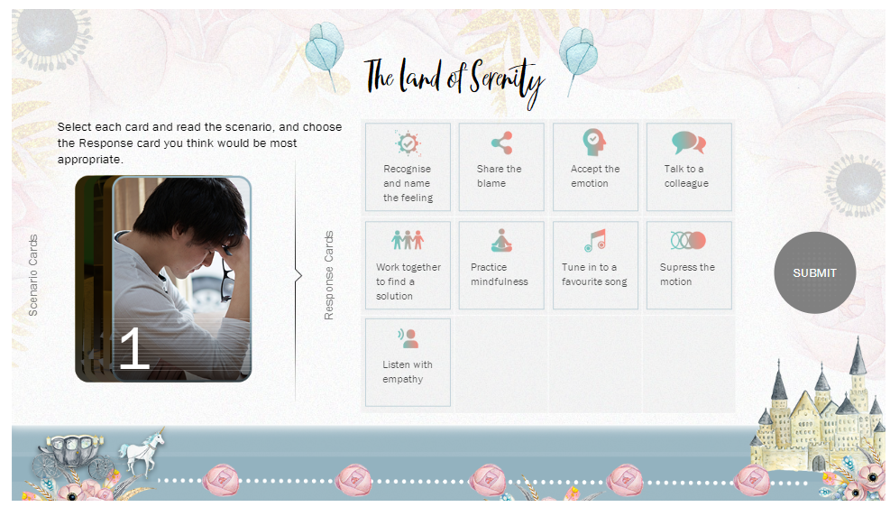
Select each card and read the scenario, and choose the Response card you think would be most appropriate.
<write voice over text here>
Recognise and name the feeling
Share the blame
Accept the emotion
Response Cards
Talk to a colleague
Work together to find a solution
1
<include graphic notes here>
Submit

Slide 4
Select each card and read the scenario, and choose the Response card you think would be most appropriate.
<write voice over text here>
Recognise and name the feeling
Share the blame
Accept the emotion
It’s been a week since Mark started feeling RESTLESS and DISTRACTED at work. Meetings, chats and emails lead his day and he’s just not able to focus on a new deliverable which is due soon.
Mark should…
Response Cards
Talk to a colleague
Work together to find a solution
<include graphic notes here>
Submit

Slide 5
Well done!
Practicing mindfulness – the practice of living with complete attention to the present moment – will help Mark in directing his attention towards tasks that matter the most.
Select each card and read the scenario, and choose the Response card you think would be most appropriate.
<write voice over text here>
Recognise and name the feeling
Share the blame
Accept the emotion
It’s been a week since Mark started feeling RESTLESS and DISTRACTED at work. Meetings, chats and emails lead his day and he’s just not able to focus on a new deliverable which is due soon.
Mark should…
Response Cards
Talk to a colleague
Work together to find a solution
Continue
Work together to find a solution
<include graphic notes here>
Submit

Slide 6

You
travelled %Score%
out of 100
miles.
Congratulations!
You have now completed this game.
Play again
<include graphic notes here>
For more useful insights on emotions and
how to manage them, explore our training!
Visit course

