Slide 1
Approaches
Gamification Approach for the CSS Course

Slide 2
Gamification Approach for the CSS Course
Background information and module journey:
7 modules
At the beginning of the course (M0), a character called ‘Super Salesperson’ will give the learners a mission to achieve a sales target (in $).
The target value will be divided between modules 1 to 7 - each module will have its own target.
Within each module, the target will be divided between the sections (buckets) – each bucket will have a target value weightage.
The resources section will carry some ‘bonus’ value.
Module journey
Learn
Apply
Practice
(Conv model)
Test
Resources

Slide 3
Gamification Approach for the CSS Course
Learn
Apply
Practice
(Conv model)
Test
Resources
Mission Goal - $1700
$200
$300
$500
$500 (assuming 5q)
$200 (bonus)
Earned by completing the Learn section
Earned by correctly answering the questions in the Apply section in the first go.
Earned by correct handling of the conversation
Earned by correctly answering the questions in the Apply section in the shortest possible time. E.g., 5 minutes for 5 questions
Earned by reading all the ‘Resources’
Practice and Test:
100% score is rewarded on first attempt right
50% score is rewarded on second attempt right
0% score is rewarded on third attempt onwards

Slide 4
MEDALS
Gamification Approach for the CSS Course
On successfully achieving the target, the learner will be awarded medals of honor based on the earned target value at the end of each module.
Novice Planner
$1100 to $1300
Planner in Practice
$1300 to $1500
Master Planner
$1500 - $1700
If the learner achieves <1100 $, they will be prompted to revisit the module.

Slide 5
Gamification Approach for the CSS Course
Game mechanics
Learning agent: The character ‘Super Salesperson’ (SS) will be introduced to the learners in beginning.
The role of the SS will be to:
Introduce the sales targets to the learner at the beginning of each module.
Prompt the learner to score well and become a Star themselves in M8 (Final Assessment).
E.g., if the learner scores well, the SS can award a ‘Star of Sales’ trophy/crown. “You are now the ‘Star of Sales’. Go ahead and ace …”
Additionally, the SS may also give feedback for questions (in Apply and Test sections).
You are now the ‘Star of Sales’. Go ahead and ace …”

Slide 6
Gamification Approach for the CSS Course
Game mechanics
Target in $ value: In the beginning of the course, learners will be given a sales target (in $ value) to achieve in the entire course. (Instead of points, it will be more relevant to have a sales target.) They achieve the target progressively as they go on completing each module.
The achieved target can reflect on the GUI at the top. This will be cumulative as they go on completing each section (bucket).

Slide 7
Gamification Approach for the CSS Course
Scoreboard
Learn
$200
Apply
$200
Practice
$300
Test
$300
Resources
$300
2 out of 5 Decision points are right!
3 / 5 Quizzes completed right!
You earned $1300 and you earned silver badge
You are a “Planner in Practice “

Slide 8
Extended gamification outside of the module (LMS platform)

Slide 9
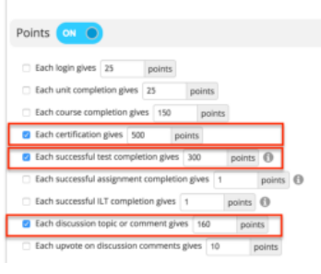
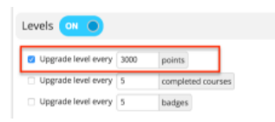
BADGES
Extended gamification outside of the module (LMS platform)
Note: According to the point setup shown here, the learner would have to successfully pass 4 tests, acquire 2 certificates, and have contributed to at least 5 discussions in order to collect the required points to move on to the next level.
Define levels:
Upgrade level every <500> points
Upgrade level every <5> completed modules
Upgrade level every <5> badges
LMS settings on points and badges

