Slide 1
Solution Blueprints
Completed project solutions
Prepared for: Knowledge Repository
16th Oct 2020

Slide 2
Topic
Brokering for different regions and ITAR Part 130 (US-specific)
Business goal
Making employees aware of brokering and ITAR Part 130, and apply these in their role at Airbus
Approach
Two key characters sharing their experiences in these regions through compelling storytelling
Key Highlights
Story-based narrative
Well-chunked content
Infographics
Conversations
Diverse visual layouts and templates
Fully audio driven approach
Scenario-based knowledge checks
Intuitive interactivities
Reminders and notes at logical junctures

Slide 3
Introduction video
Navigation (help) screen
Learning objectives
Visual menu (learning journey)
Topic 1
Character introduction
Branching screen for different stories (by region)
Four different stories told in a similar format
Topic 2
One thread of the four stories expanded (US region)
Conclusion
Assessment
Situation-based questions with 80% pass percentage
Initial key characters conclude the course

Slide 4
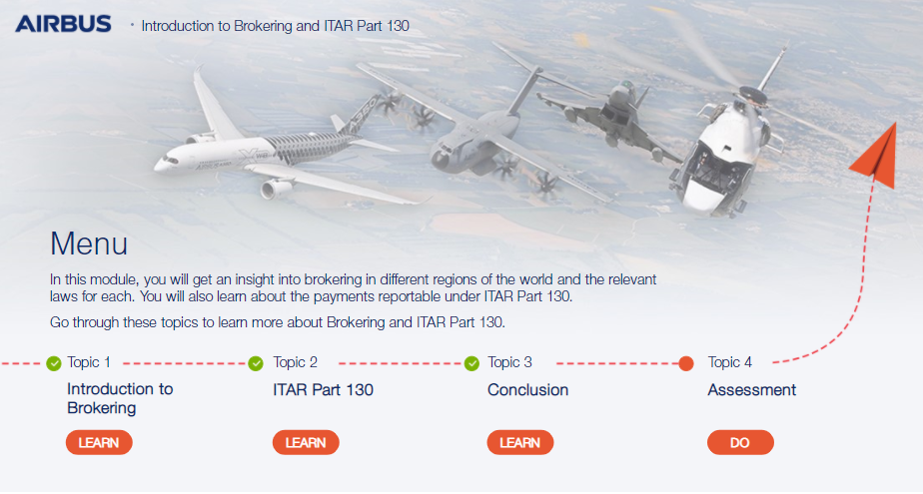
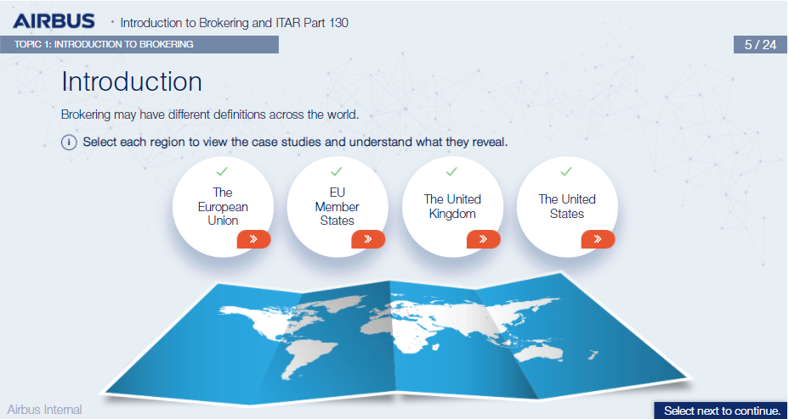
Visual Menu
Branching screen

Slide 5
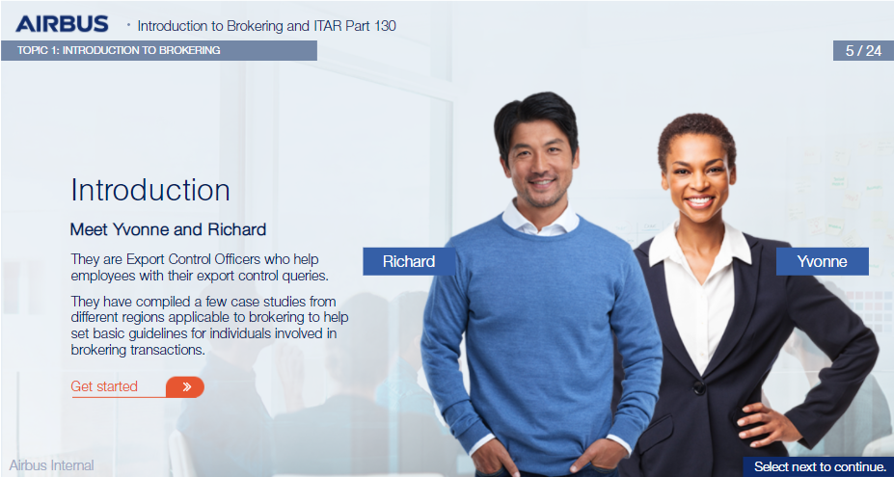
Overarching characters

Slide 6
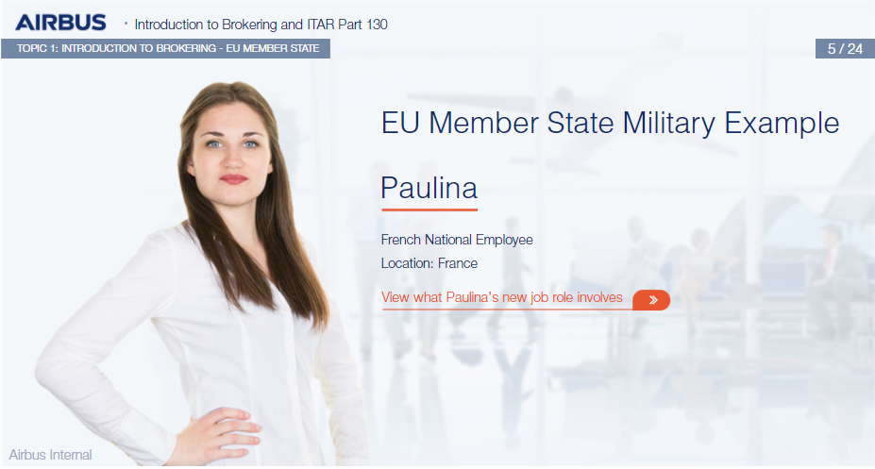
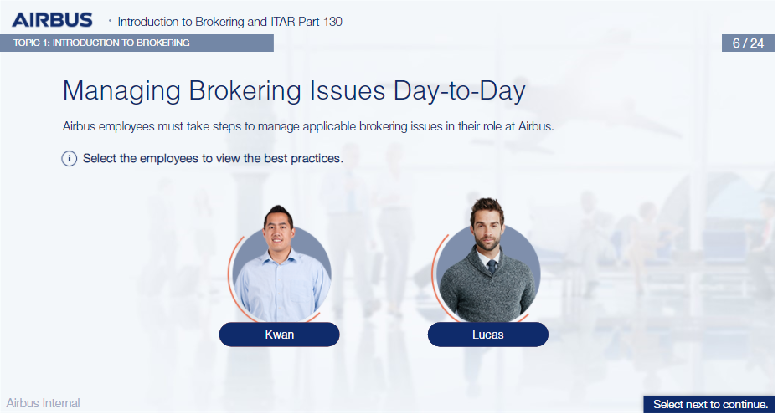
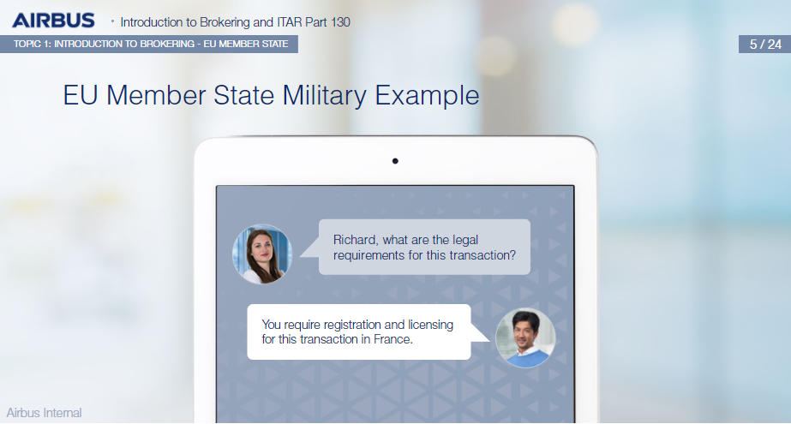
Story-based screens and characters

Slide 7
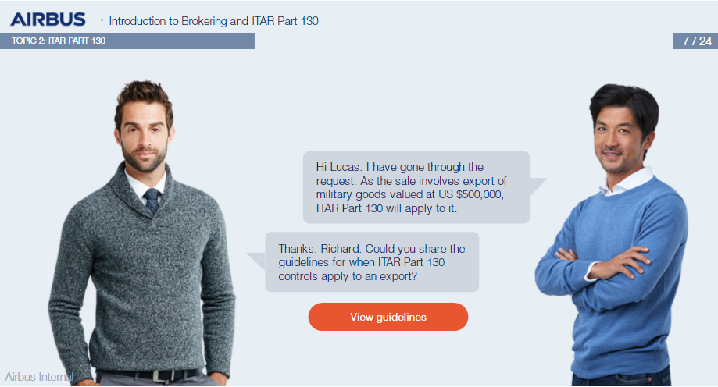
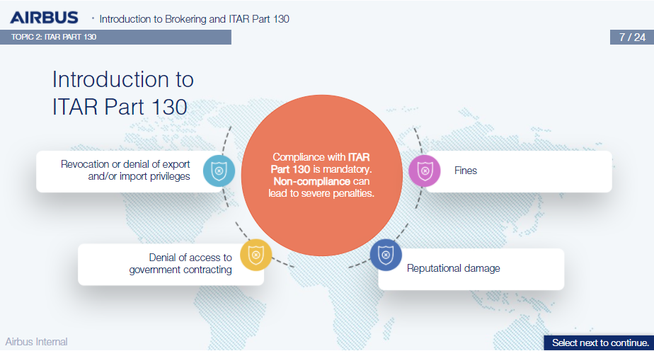
Continuing the thread for one region (ITAR Part 130 is US-specific)

Slide 8
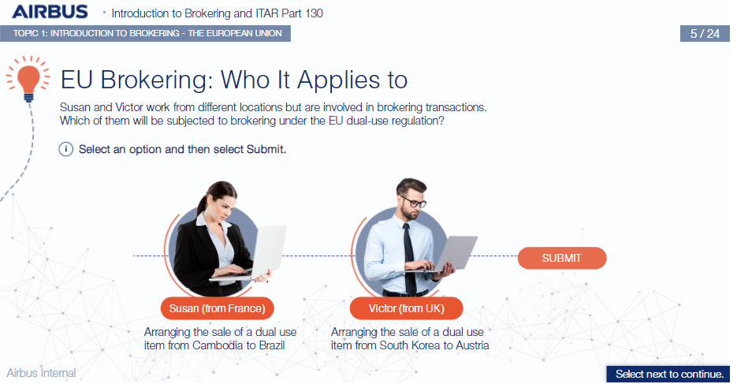
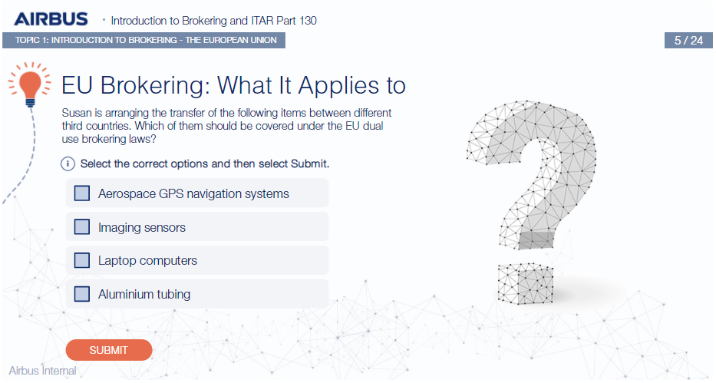
Scenario-based questions

Slide 9
Scenario-based questions

