Slide 1
Solution Blueprints
Completed project solutions
Prepared for: Knowledge Repository
15th Oct 2020

Slide 2
Topic
Data Security and Data Handling
Business Objective
Build awareness on data security
Demonstrate ways of mitigating data security risks
Share best practices on data handling
Approach
A gamified learning driven through a single character or avatar who is on a mission to earn trust points from customers as he or she navigates through the different security levels embedded in the course.
Key Highlights
Gamified Learning on Data security
Includes all gaming elements (Avatar Selection, Scoring, Rewards, Penalties, Badges)
Avatars are close to real-life characters in Amazon and helps in instantly connecting with the target audience
Use of real situations or scenarios for greater impact
With Spoiler alerts, decision points and an overarching story the learner is beautifully hooked to the game all the way till completion
Partially audio driven
Built on Storyline 360
Leverages the Parallax platform for linear navigation

Slide 3
Amazon AWS Games
3
Game Introduction
Game Obj/Purpose/Rules/Avatar Selection
Landing Page
(Context setting Videos)
Level 1
Interactions
Decision Points
Users need to complete all stages within the specified time.
Navigation is linear.
Learners are scored based on their performance on the decision points and final assessment.
Interactive Learning
All the three levels follow identical progression
Level 1 Completion
Level 2, 3
4 Stages completed
Scores and Badges
Scores and Badges
Users feedback

Slide 4
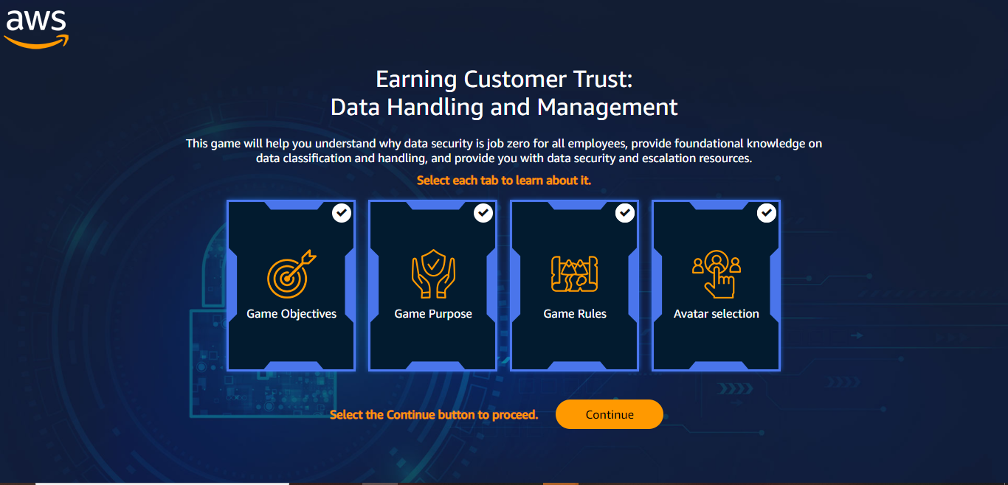
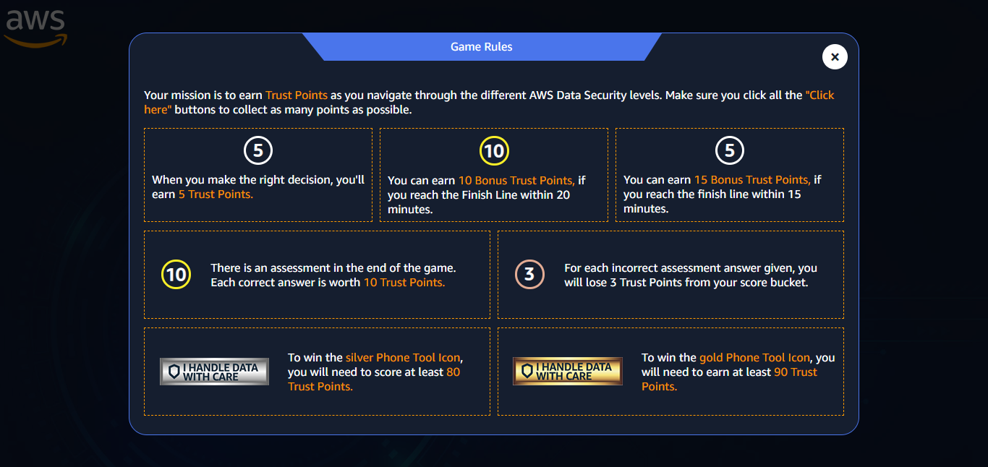
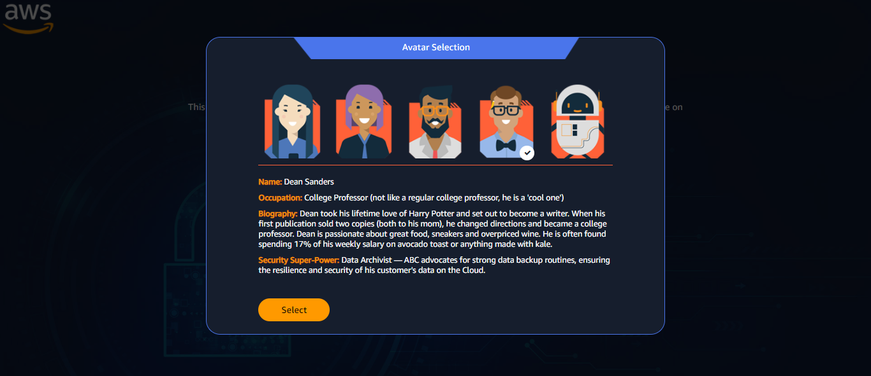
GAMING ELEMENTS

Slide 5
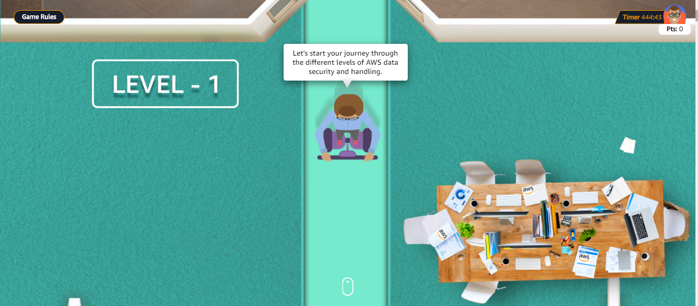
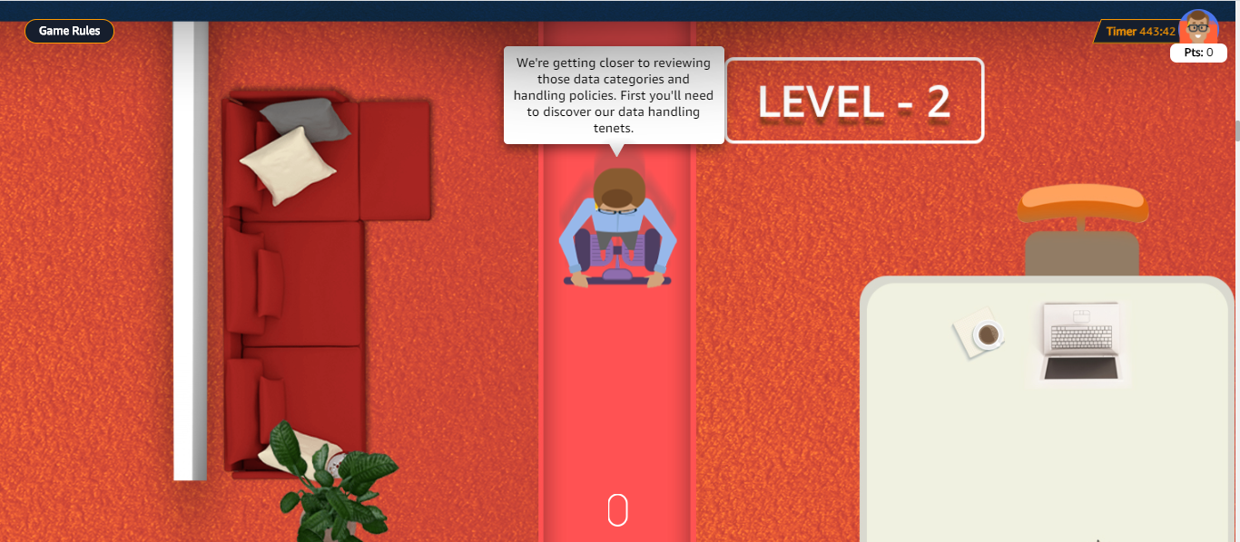
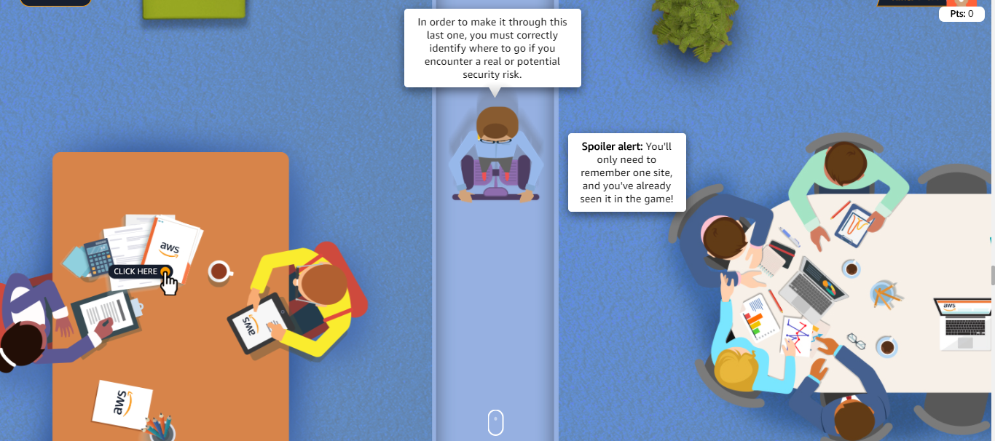
GAME LEVELS

Slide 6
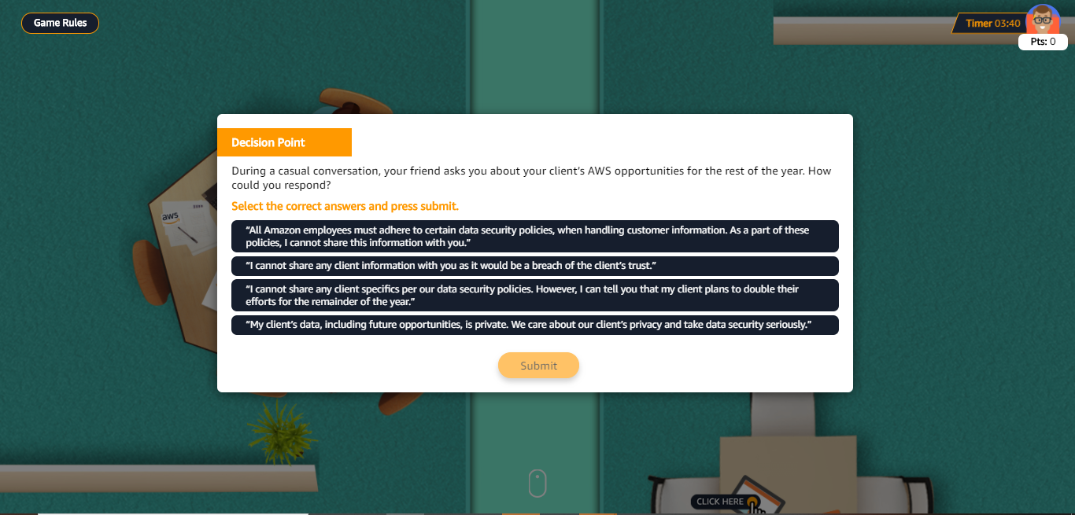
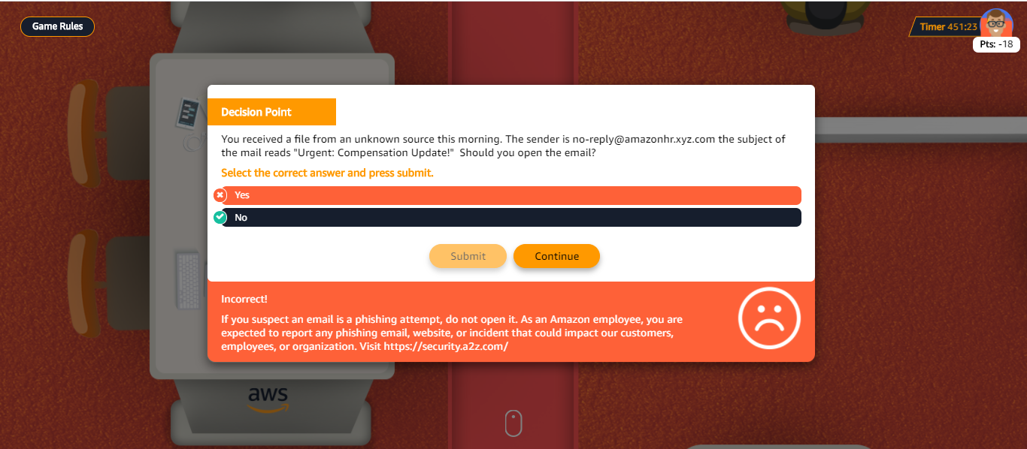
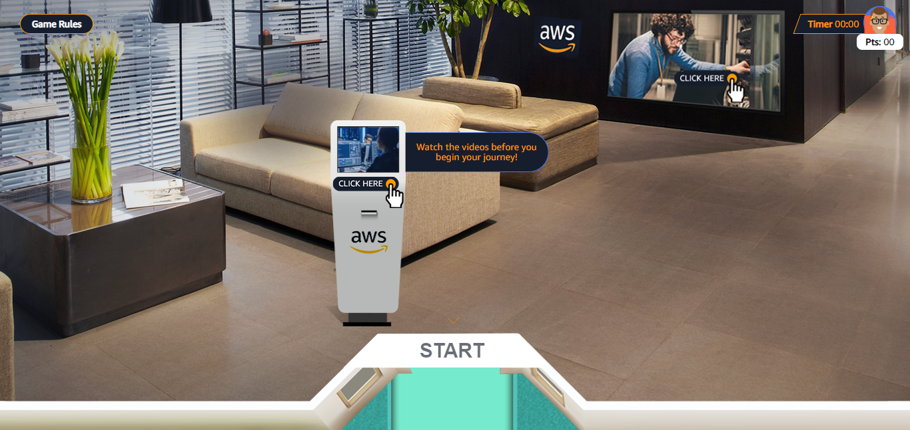
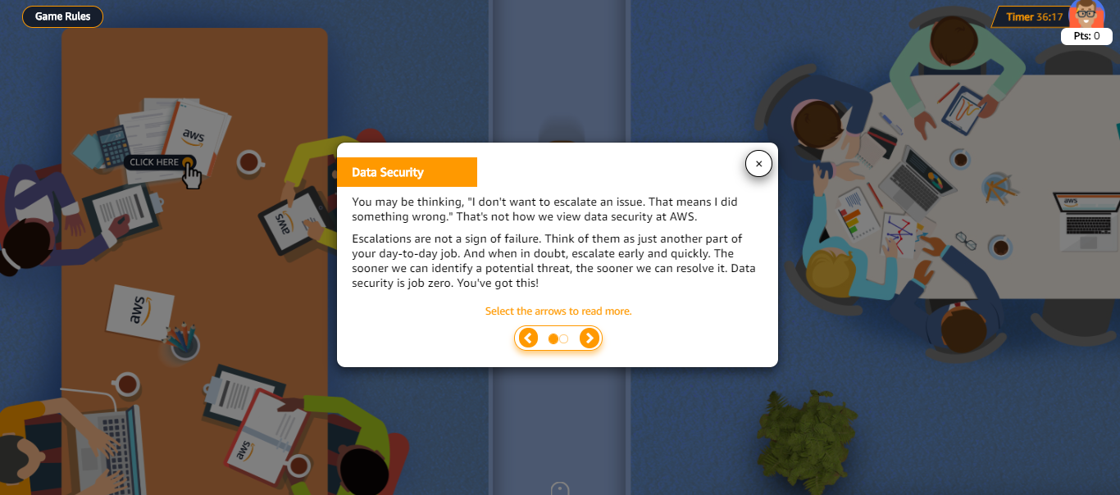
INTERACTIVITIES

