Slide 1


Solution Blueprints
Completed project solutions
Prepared for: Knowledge Repository
6th Nov 2020

Slide 2
Topic
Nuances and various aspects of the Legal Hold subject (in PMI’s context)
Business goal
Awareness and knowhow of different Legal Hold parameters as part of PMI’s Compliance Mandate
Approach
Personalized, character-driven, scenario-based learning with several immersive elements
Key Highlights
Personalization through avatar selection
Derivate learning (scenario-based approach)
Intuitive interactivities
Participative decision-making interventions
Relatable characters who drive the learning
Information highlights
Well-woven conversational interactions
Diverse visual layouts and templates
Post-training survey for learner feedback

Slide 3
Welcome
Character introduction
Avatar Selection
Context Setting Scenario
(Derivative Learning)
Topics
Thematic scenario
Conversations, decision making, immersive learning
Iterative Learning
Conclusion
Survey
Course effectiveness evaluation
Initial key characters conclude the course
**Combination pattern followed for all topics
Revisit Option for All Topics

Slide 4
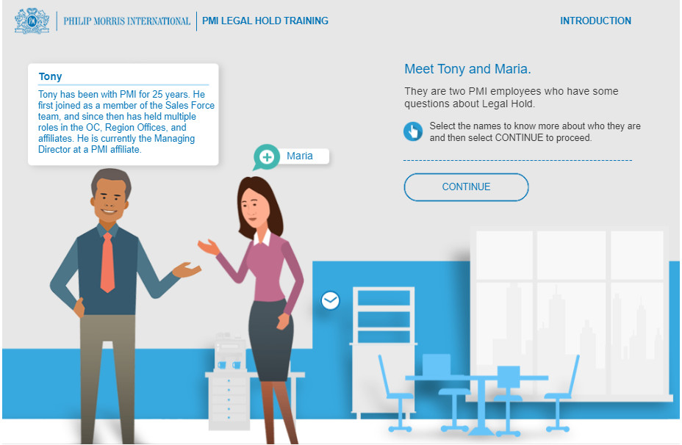
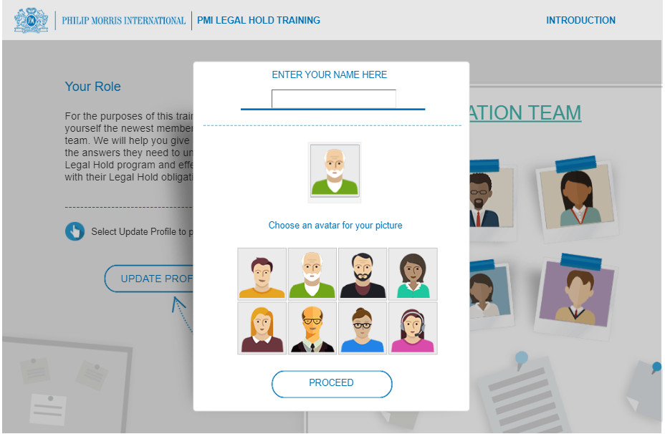
Character Introduction
Avatar Selection

Slide 5
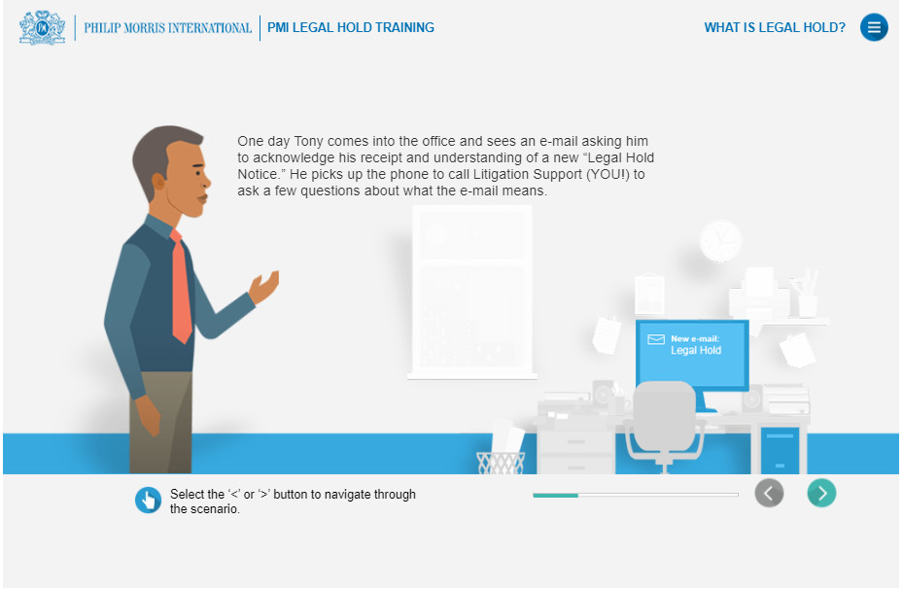
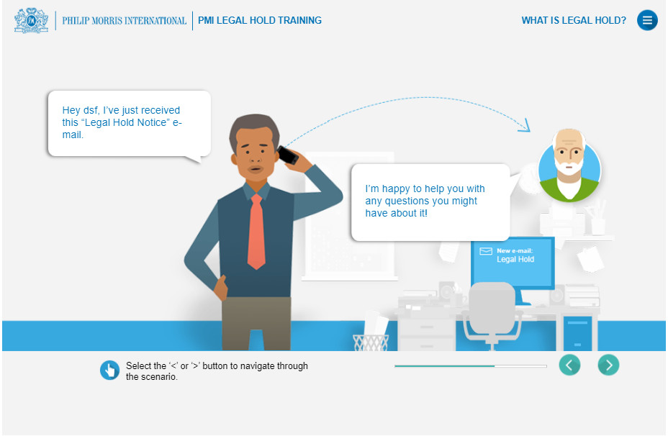
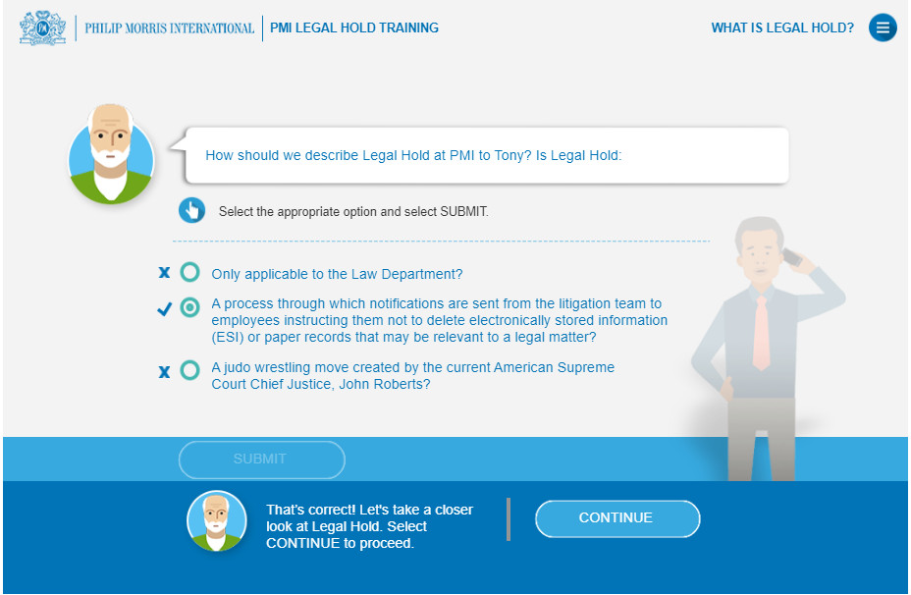
Scenario-based Learning

Slide 6
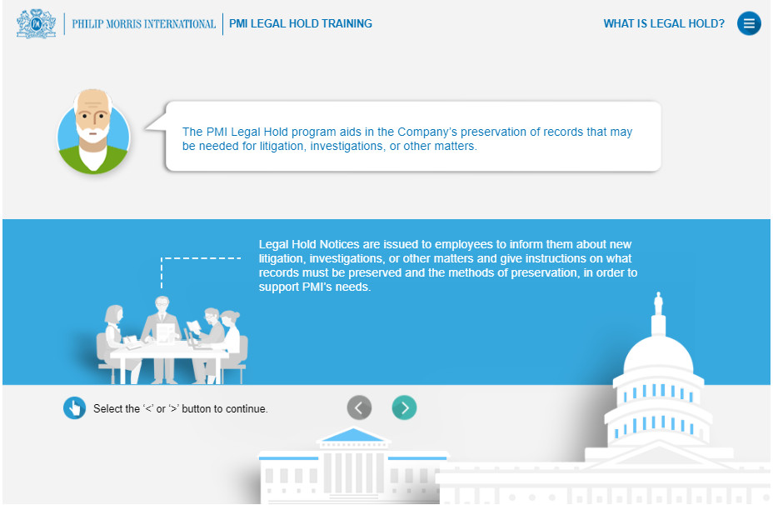
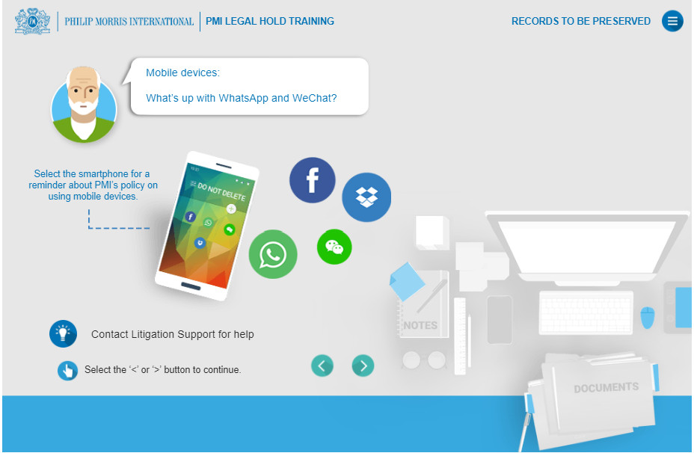
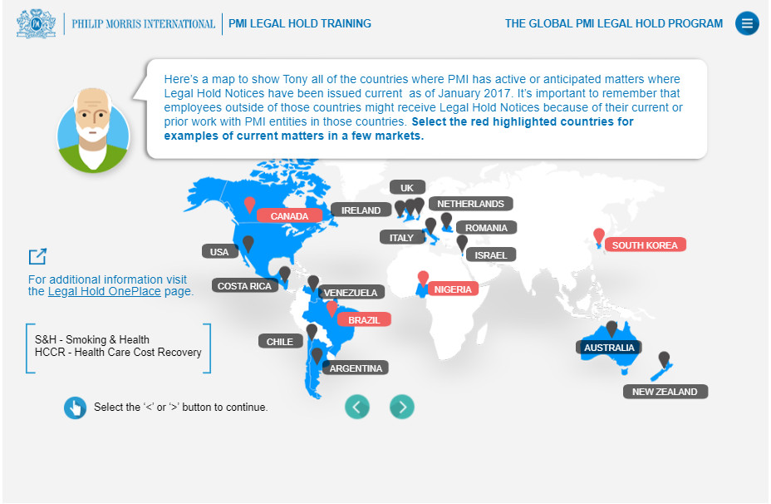
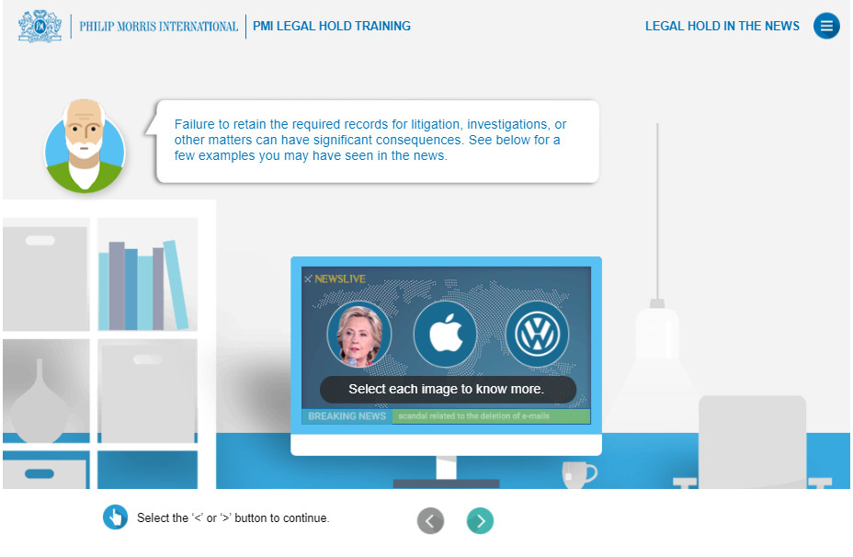
Immersive Learning

Slide 7
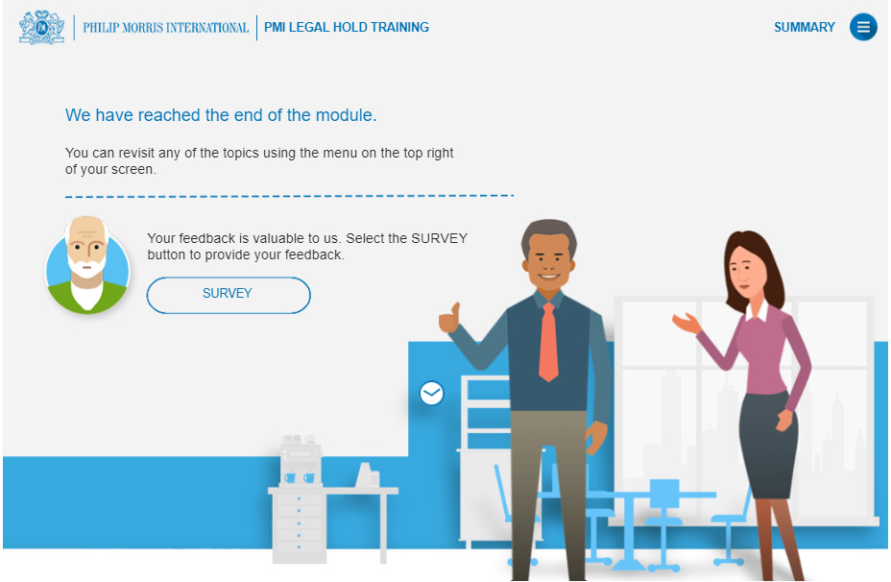
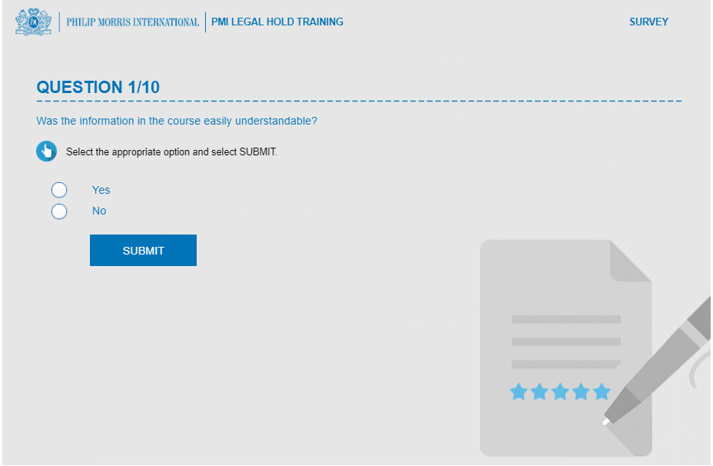
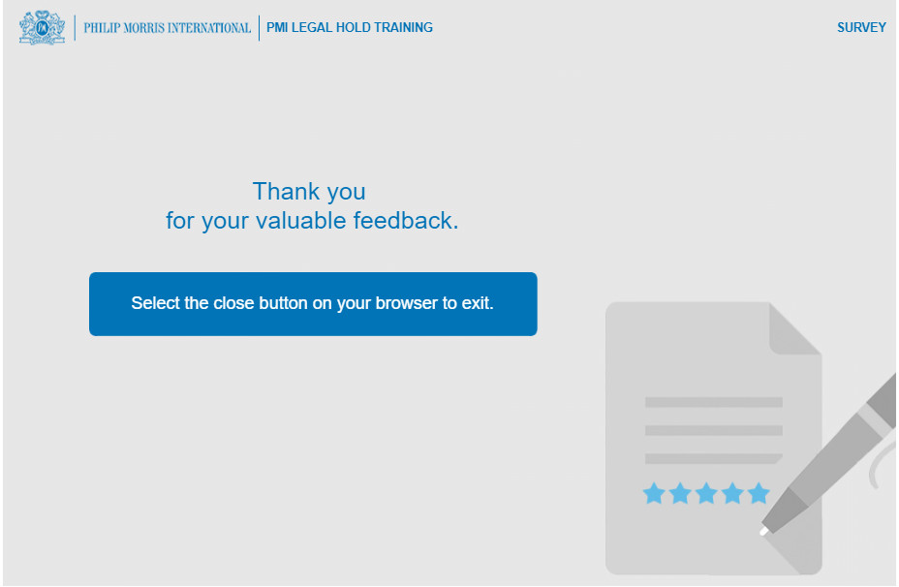
Effectiveness Survey

Slide 8
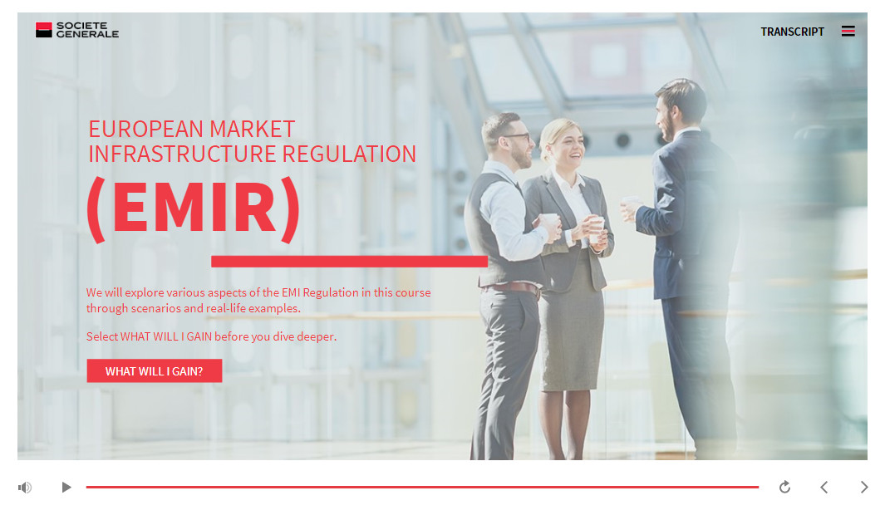
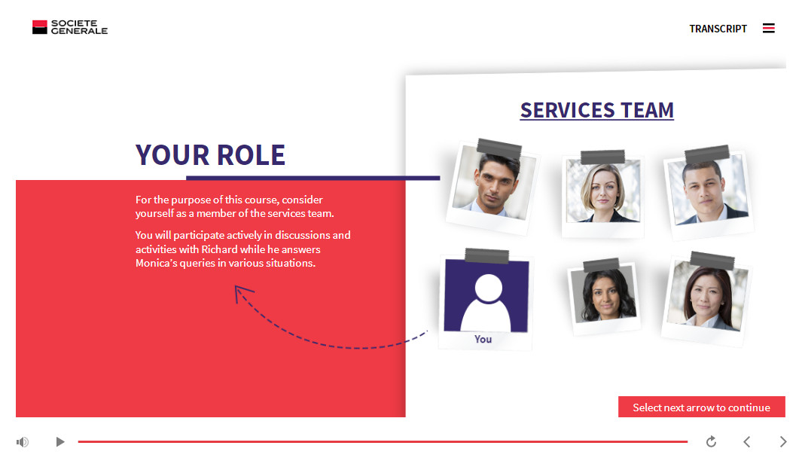
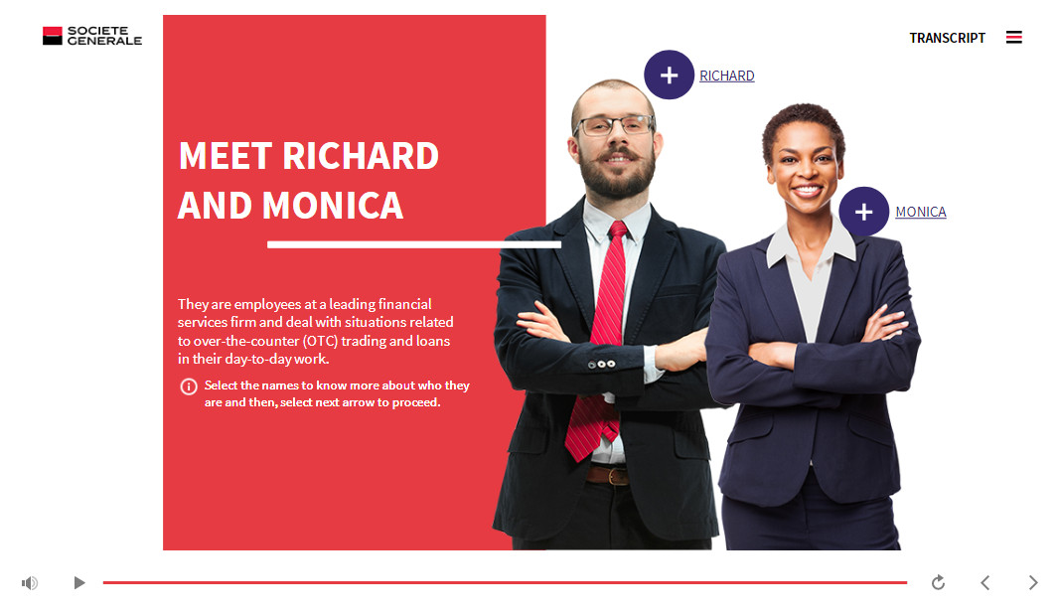

Slide 9
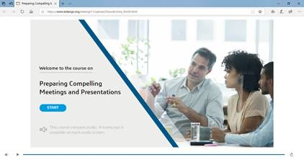
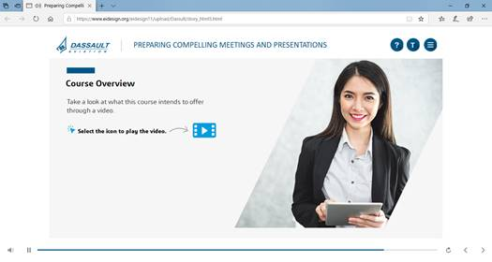
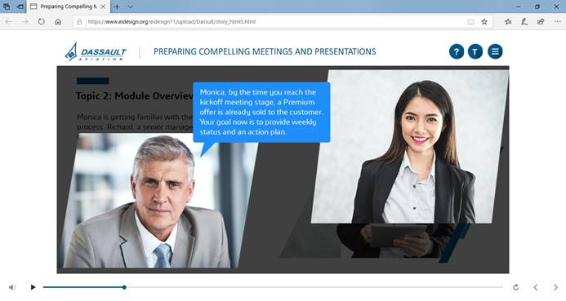
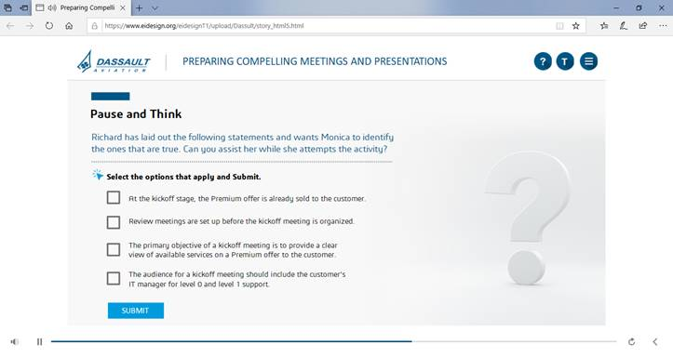

Slide 10
