Slide 1
Solution Blueprints
Completed project solutions
Prepared for: Knowledge Repository
15th Oct 2020

Slide 2
Regal Cinemas
2
What’s this all about?
The Regal Cinemas project is targeted to their young employees who work as the Cast Members and Team Leads. The multi-module project involves activities like cash handling, maximizing guest experience, general and fire safety, Regal community affairs and charity programs and so on. The moderators who pose as Regal employees go though varied scenarios to watch, learn and practice to hone their skills at Regal counters.

Slide 3
Regal Cinemas
Regal Cash Handling – Landing page
Key highlights:
CinemaScope experience
Watch, Learn, Practice, Read More approach taken
Short explanatory videos were created to set contexts to certain nuggets
Completely audio-driven
Includes moderators as Regal employees
Two avatars as Regal employees. One Team Lead and the other a Cast Member. Storyline characters presented in a brand new way
Real-time Regal Cinema case studies used to depict the actual processes at the theatre (Welcoming a guest, counting change …)
Videos have an attractive reel changing effect
Customized theatre hall backdrop created
The graphics, colours and light-effects help the project stand out
Overview
Real-time Regal Cinema visuals are used in these introductory videos with an effect of the camera reel moving …
Visual Menu (Watch/Learn/Practice/Read More
Context setting video – ‘Watch’
(Meet the moderators)
Fictitious scenarios are written to create crisis situations at the Cast members’ counter. Next, the users are involved there to learn about the ideal processes and mitigate the problem situation. The knowledge check activities include real-time cash counting (designed through customized screen animation) and problem-solving scenarios.
Content scenario activity and best practices
The Practice sessions involve conversational scenarios, guest-welcome scenarios with questions, MCQs with constructive feedback.
Content conversation screen/Activity/Best practices
Do it yourself (Practice)
Job aids on steps to count change, premium film formats (3D, 4D, IMAX), key takeaways and so on
Job aids

Slide 4
Regal Cinemas
4
Ivy
The Moderators!
Carmen
Jayce
Louis

Slide 5
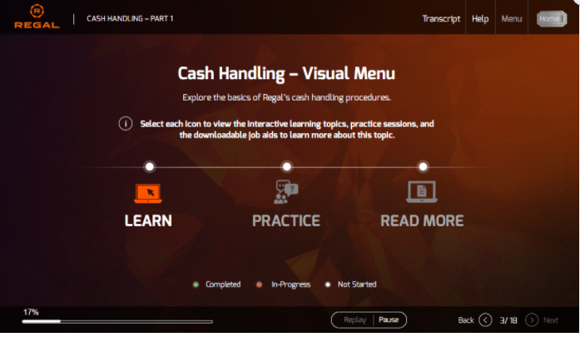
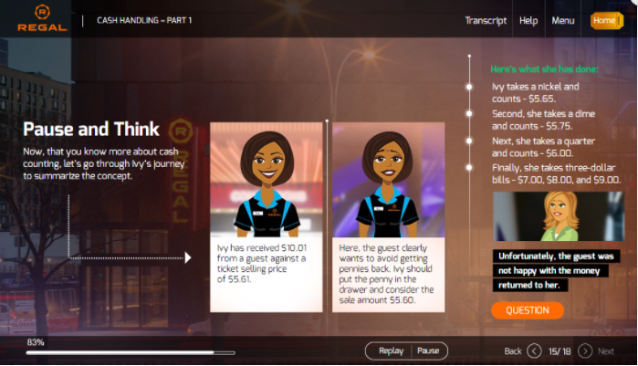
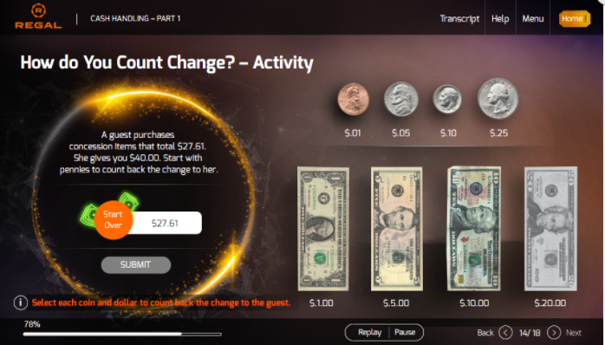
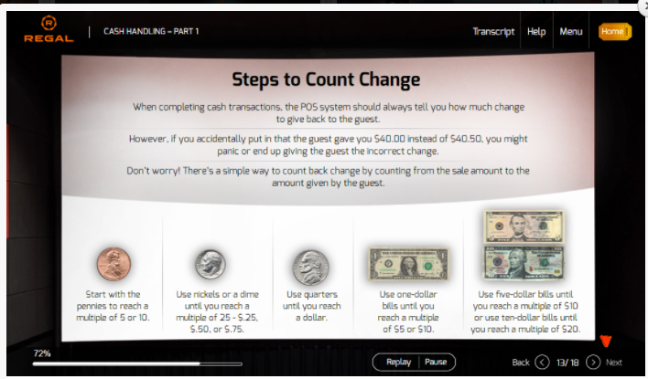
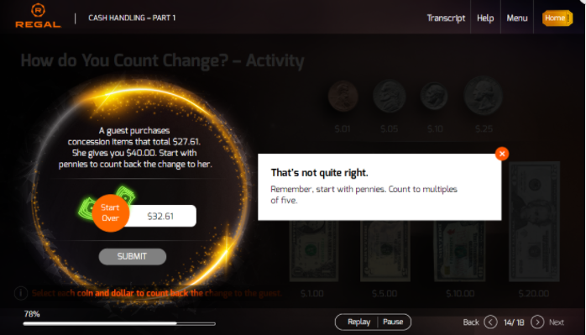
Regal Cinemas
5
Notes:
Score logic:
Attempt 1: User answer wrong, provide try again option.
Attempt 2: user answer correct, move forward, add points to the score
Attempt 1: user answer correct, move forward and add points to the score
Attempt 2: user answer wrong again, allow user to move forward but don’t add points

Slide 6
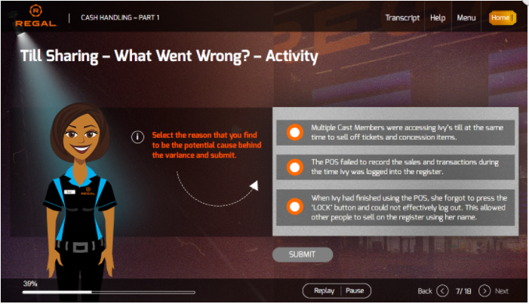
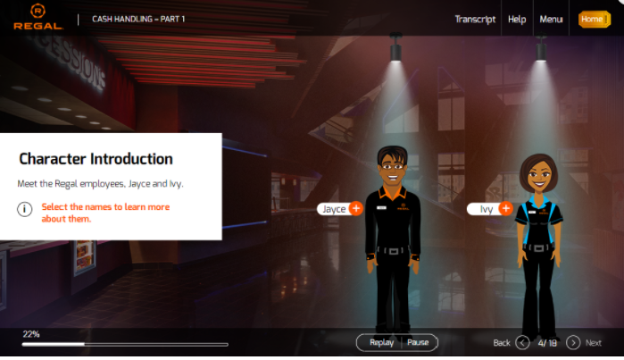
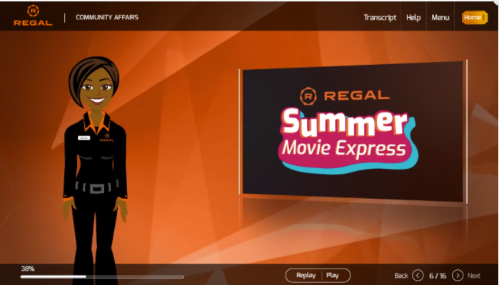
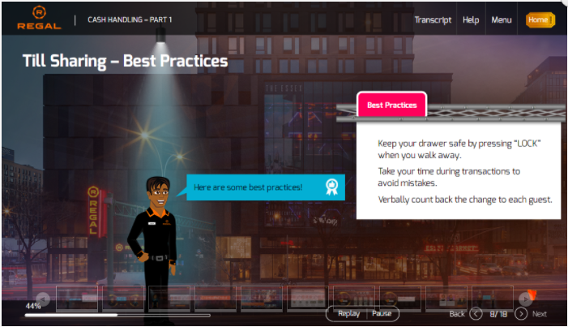
Regal Cinemas
6
Notes:
Score logic:
Attempt 1: User answer wrong, provide try again option.
Attempt 2: user answer correct, move forward, add points to the score
Attempt 1: user answer correct, move forward and add points to the score
Attempt 2: user answer wrong again, allow user to move forward but don’t add points

Slide 7
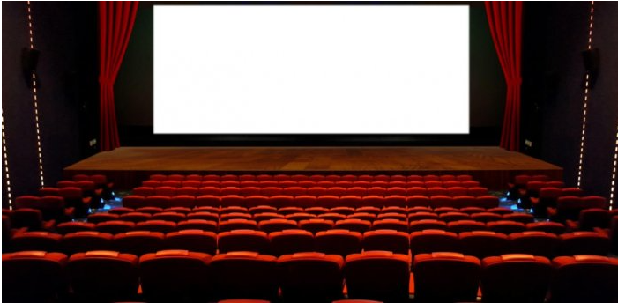
Thank You

