Slide 1
Activity sheets
Leadership:
Time management prioritization activity
Print enough copies each of slides 2-3, so that each team has a full set. These will need to be cut into cards.
VUCA case study challenge
Print 1 copy of each of slides 4-10.
For the complexity cards on slide 11, these will need to be cut into cards.
Team First:
Team First challenge
Print 1 copy of each of slides 12-15.
Note: these activities are mapped to the “ILT_ Facilitator Guide (FG)_ sample”

Slide 2
Respond to angry guest in restaurant
Time management prioritization activity
Catch up with a former associate over a long lunch
Respond to angry guest on Subway® Listens
Prepare your tax returns a few months in advance
Go on a long drive

Slide 3
Respond to angry guest in restaurant
Time management prioritization activity
Catch up with a former associate over a long lunch
Respond to angry guest on Subway® Listens
Prepare your tax returns a few months in advance
Go on a long drive

Slide 4
VUCA CASE STUDY CHALLENGE
VOLATILITY
You have set up your restaurant and business was looking good. Unfortunately, a natural disaster struck a nearby locality where your main suppliers of meat and veggies were situated, taking them off-line. Now you need to pay much higher prices for these ingredients and you have no idea when the situation is expected to return to normal. How will you respond?

Slide 5
VUCA CASE STUDY CHALLENGE
VOLATILITY
You have set up your restaurant and business was looking good. You needed to travel to another city for a week-long conference and left your trusted manager in charge of the restaurant. On the first day of the conference, you received a message that your manager would be unable to come to work indefinitely due a medical emergency. How will you respond?

Slide 6
VUCA CASE STUDY CHALLENGE
UNCERTAINTY
You set up your restaurant at a prime location. Business was picking up but in the first month itself, a direct competitor opened up a restaurant right next to yours. Suddenly, the future looks uncertain as your guests get split between the two restaurants. How will you respond?

Slide 7
VUCA CASE STUDY CHALLENGE
UNCERTAINTY
You’ve taken over your new restaurant and everything goes well for the first few weeks. Then, without warning, Team Members suddenly begin quitting. You are uncertain why this is happening. How will you respond?

Slide 8
VUCA CASE STUDY CHALLENGE
COMPLEXITY
You set up your restaurant and have a steady stream of guests from the local community. A large event was planned at a different location far away, but at the last minute, the venue was shifted to a location right next to your restaurant. Suddenly, your restaurant is flooded with guests as well as multiple catering orders.

Slide 9
VUCA CASE STUDY CHALLENGE
AMBIGUITY
You have considerable experience in running your restaurant, which is a traditional, freestanding location. You got an opportunity to set up a new restaurant in a non-traditional airport location, where the dynamics are completely different. You decide to go ahead with the non-traditional restaurant but are quite unsure of what your next steps should be. How will you respond?

Slide 10
VUCA CASE STUDY CHALLENGE
AMBIGUITY
You run a restaurant within a business district and many of your guests are from the office buildings nearby. After a sudden pandemic/crisis, you find that guest traffic has drastically dropped, your regulars have stopped visiting and there is no information at all about when the situation will return to normal. How will you respond?

Slide 11
VUCA CASE STUDY CHALLENGE – optional challenges
1. You are running low on product.
4. Your Field Consultant is arriving soon for a pre-planned coaching session.
7. The Internet went out.
2. Your delivery today is running late.
5. The speed oven broke down.
8. The freezer compressor blew a fuse.
6. The walk-in cooler isn’t working properly.
3. One Team Member didn’t show up for work.
9. The AC stopped working.

Slide 12
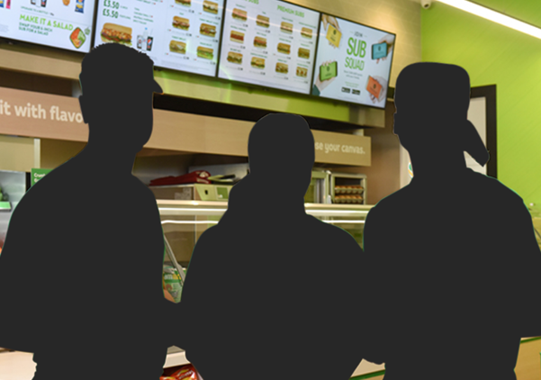
TEAM FIRST CHALLENGE
QUITTING TEAM MEMBERS
Three team members quit all at once, with no notice. Now your team is down to six, and though your remaining team members are picking up extra shifts, they’re stressed and not all shifts are fully staffed.

Slide 13
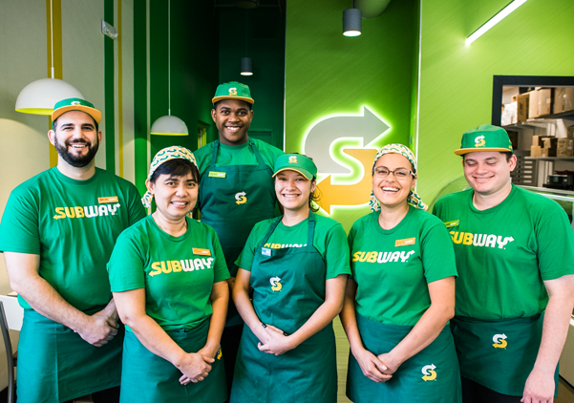
TEAM FIRST CHALLENGE
MANY NEW TEAM MEMBERS
You just hired several new team members. They’re still learning their responsibilities, and seem to be struggling a bit. There also seems to be a disconnect between them and your existing team members.

Slide 14
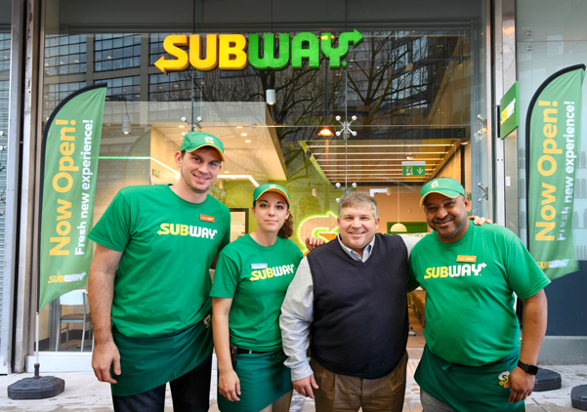
TEAM FIRST CHALLENGE
UNRELIABLE TEAM MEMBERS?
Your new location being transferred to you already has a full team. However, team members don’t seem reliable: they often call out sick with little notice, and don’t take initiative to complete tasks proactively or properly.

Slide 15
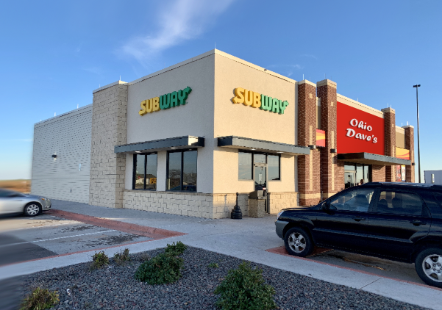
TEAM FIRST CHALLENGE
DON’T STEAL MY TEAM MEMBERS!
A direct competitor opened up nearby, and are hiring. You hear murmurings that your team members are tempted to apply for jobs with that competitor.

