Slide 1
Level 1
Static interactions
Simple Animations/Transitions
Click and reveal interactions (images, icons, tabs, Read More, etc.)
Knowledge Checks (Yes/No, True/False, SAMC, MAMC)
Assessments
Level 2
Level 1 + following
Videos
Accordion types, Flip card types, Carousel, Hotspots
Slider, Timeline
Infographics
Knowledge Checks (Yes/No, True/False, SAMC, MAMC)
Use of scenarios, scenarios followed by questions
Use of conversational types
Use of Drag and Drop interactions
Interaction
Designs
Level 3
Level 1, 2 + following
Conversational model prompting users making right decisions
Use of branching interactions – considering different scenarios, case studies with consequences, and summarise the takeaways
Crossword, Matching,
Virtual experience interactions
3D use of concepts and 3D based interactive models

Slide 2
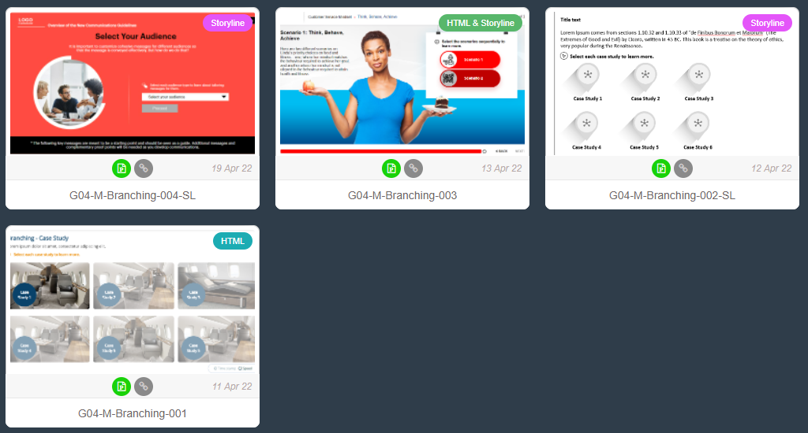
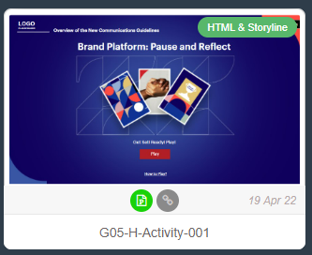

Slide 4
